Slide 1
Basic Network Analysis
Jeremy Guillette
History Department Digital Scholarship Facilitator

Slide 2
bit.ly/DFgephi

Slide 3
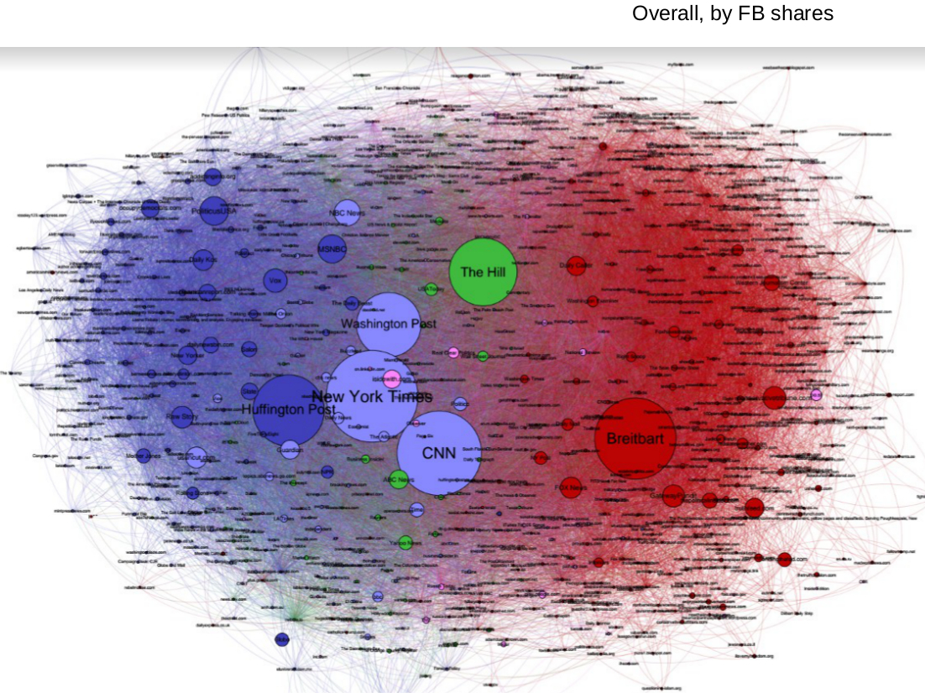
Notes:
Network analysis can be a network of news outlets, connected by common sharers on social media

Slide 4
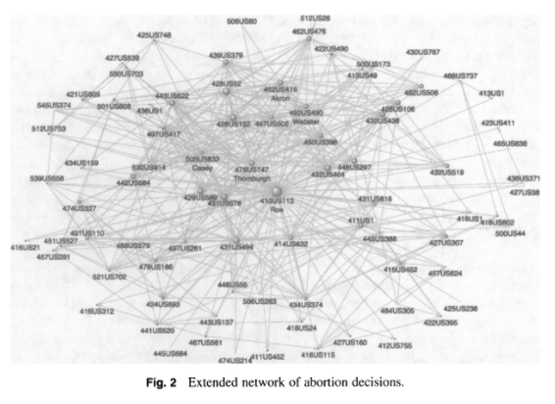
Notes:
It can be a network of supreme court cases, connected by references to each other

Slide 5
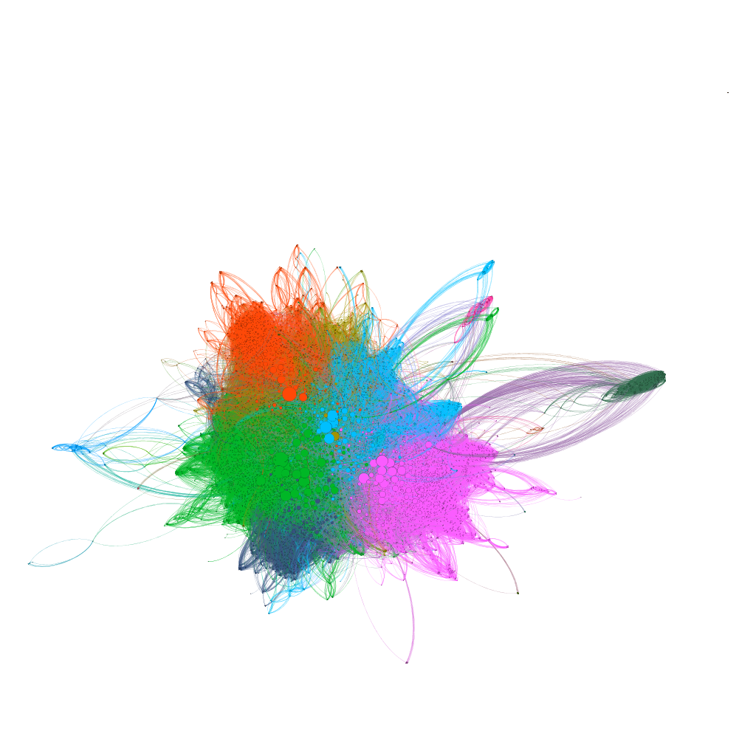
Notes:
It can also be a network of marvel characters, connected by common appearances in comic books

Slide 6
Network Analysis
Fundamentally, an analysis of nodes connected by edges
Up to you as a researcher to decide what constitutes a node and how you define your edges
Examples:
Nodes are people, and edges are defined by correspondence
Nodes are scholars, and edges are defined by co-authorship of published papers
Nodes are places, and edges are defined by roads connecting them
Notes:
This is the conceptual work that you have to do prior to any data collection and analysis: what are you fundamentally interested in looking at?

Slide 7
Gephi (gephi.org)
Free and open source software
Runs on all major operating systems
Robust analysis functions
Extensible

Slide 8
Preparing Data
Nodes Table
Edges Table
ID | Label | State | Region
13244 | MEM - Memphis, TN | Tennessee | Southeast
13246 | MEO - Manteo, NC | North Carolina | Southeast
13264 | MFR - Medford, OR | Oregon | Northwest
13296 | MHT - Manchester, NH | New Hampshire | Northeast
13303 | MIA - Miami, FL | Florida | Southeast
13342 | MKE - Milwaukee, WI | Wisconsin | Midwest
13347 | MKK - Hoolehua, HI | Hawaii | Pacific
Source | Target | Freight | Mail
13244 | 10135 | 9876409 | 0
13244 | 10140 | 37752979 | 0
13244 | 10185 | 0 | 0
13244 | 10194 | 66068 | 0
13244 | 10198 | 0 | 0
13244 | 10208 | 0 | 0
13244 | 10257 | 9361288 | 0
Notes:
Sample from dataset we'll be working with, simplified
Important thing is to have an ID in nodes table, and source and target in edges table. Label is also used, but not required. Those names are required by Gephi though, can't map other names to those ideas
ID doesn't have to be a number, but it does have to be unique

Slide 9
transtats.bts.gov/DL_SelectFields.asp?Table_ID=310
Notes:
This is where the data comes from, and in the processing folder you can take a look at the Python I used to make it, if you're interested.

Slide 10
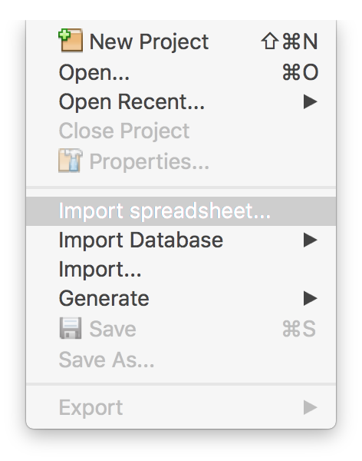
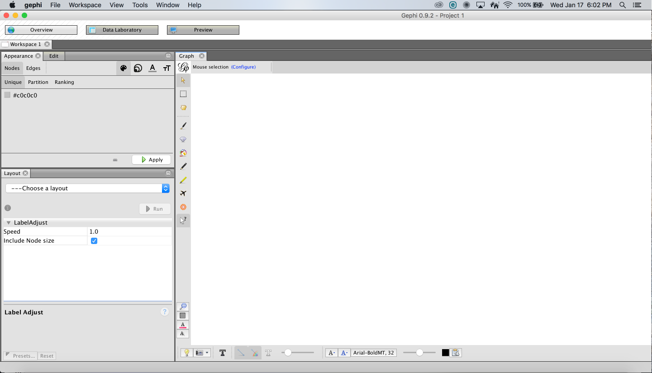
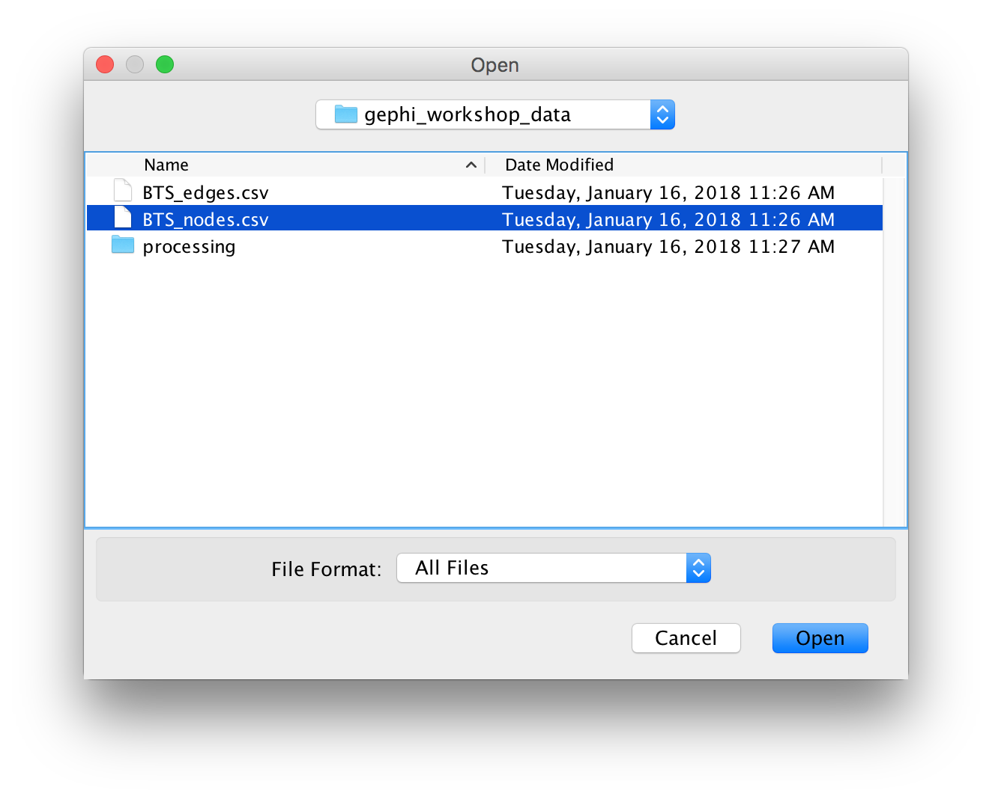

Slide 11
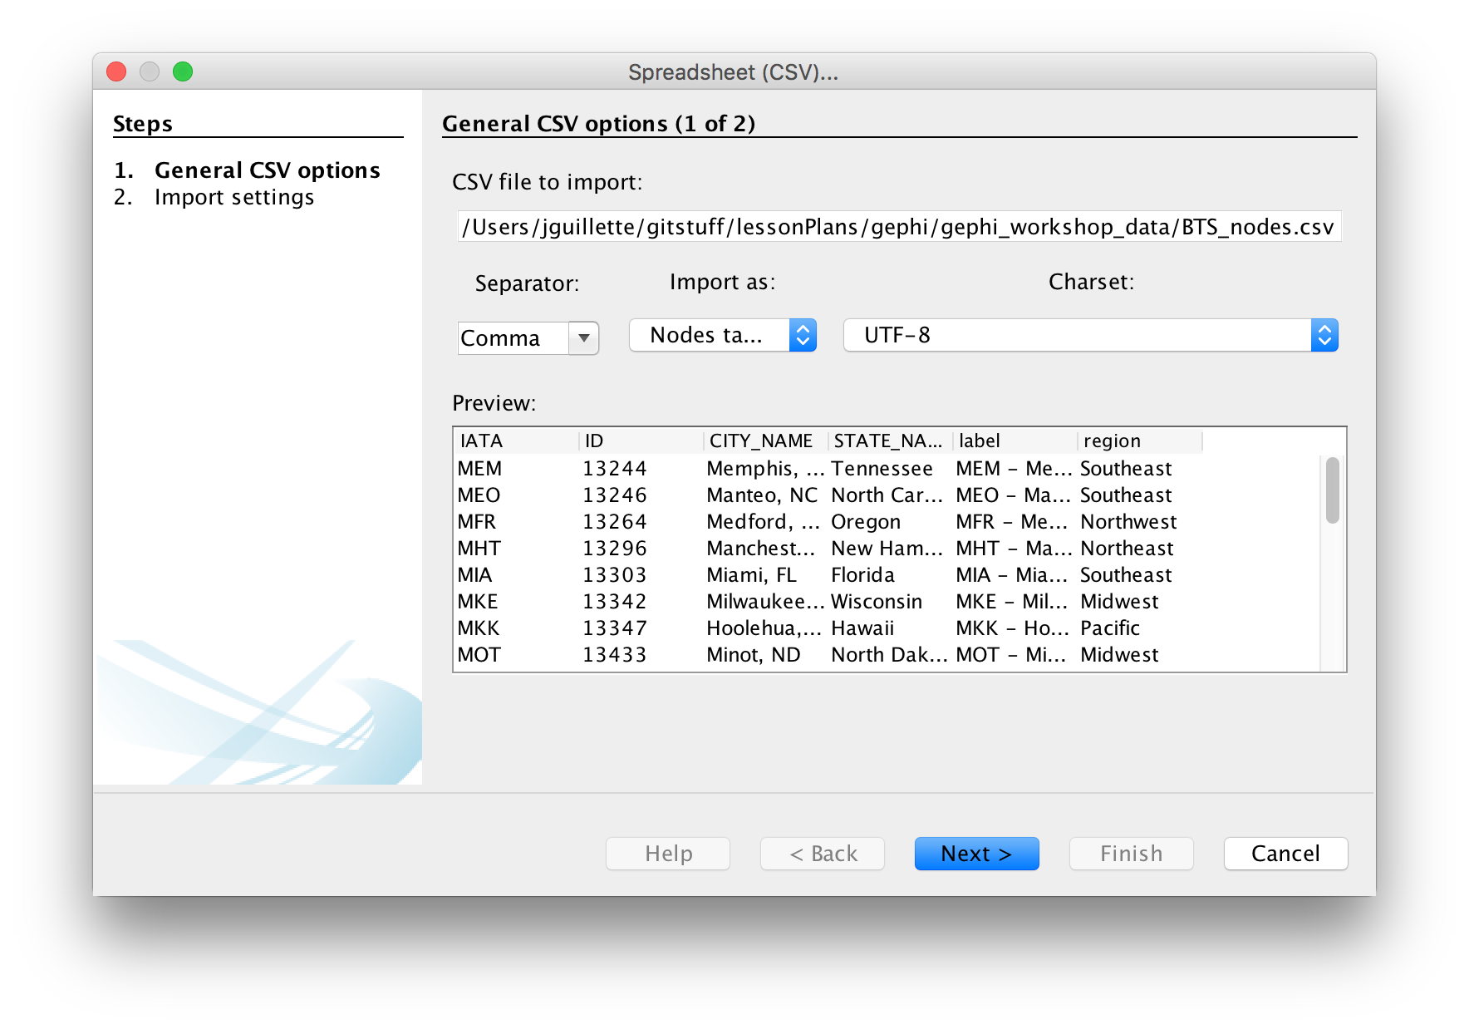
Notes:
Time to check your data. If columns are running together, check that your separator matches your file (sometimes tab is used instead of comma)
Make sure it's the right kind of data (node for now)
If characters aren't showing up right, check the encoding
If everything looks good hit next

Slide 12
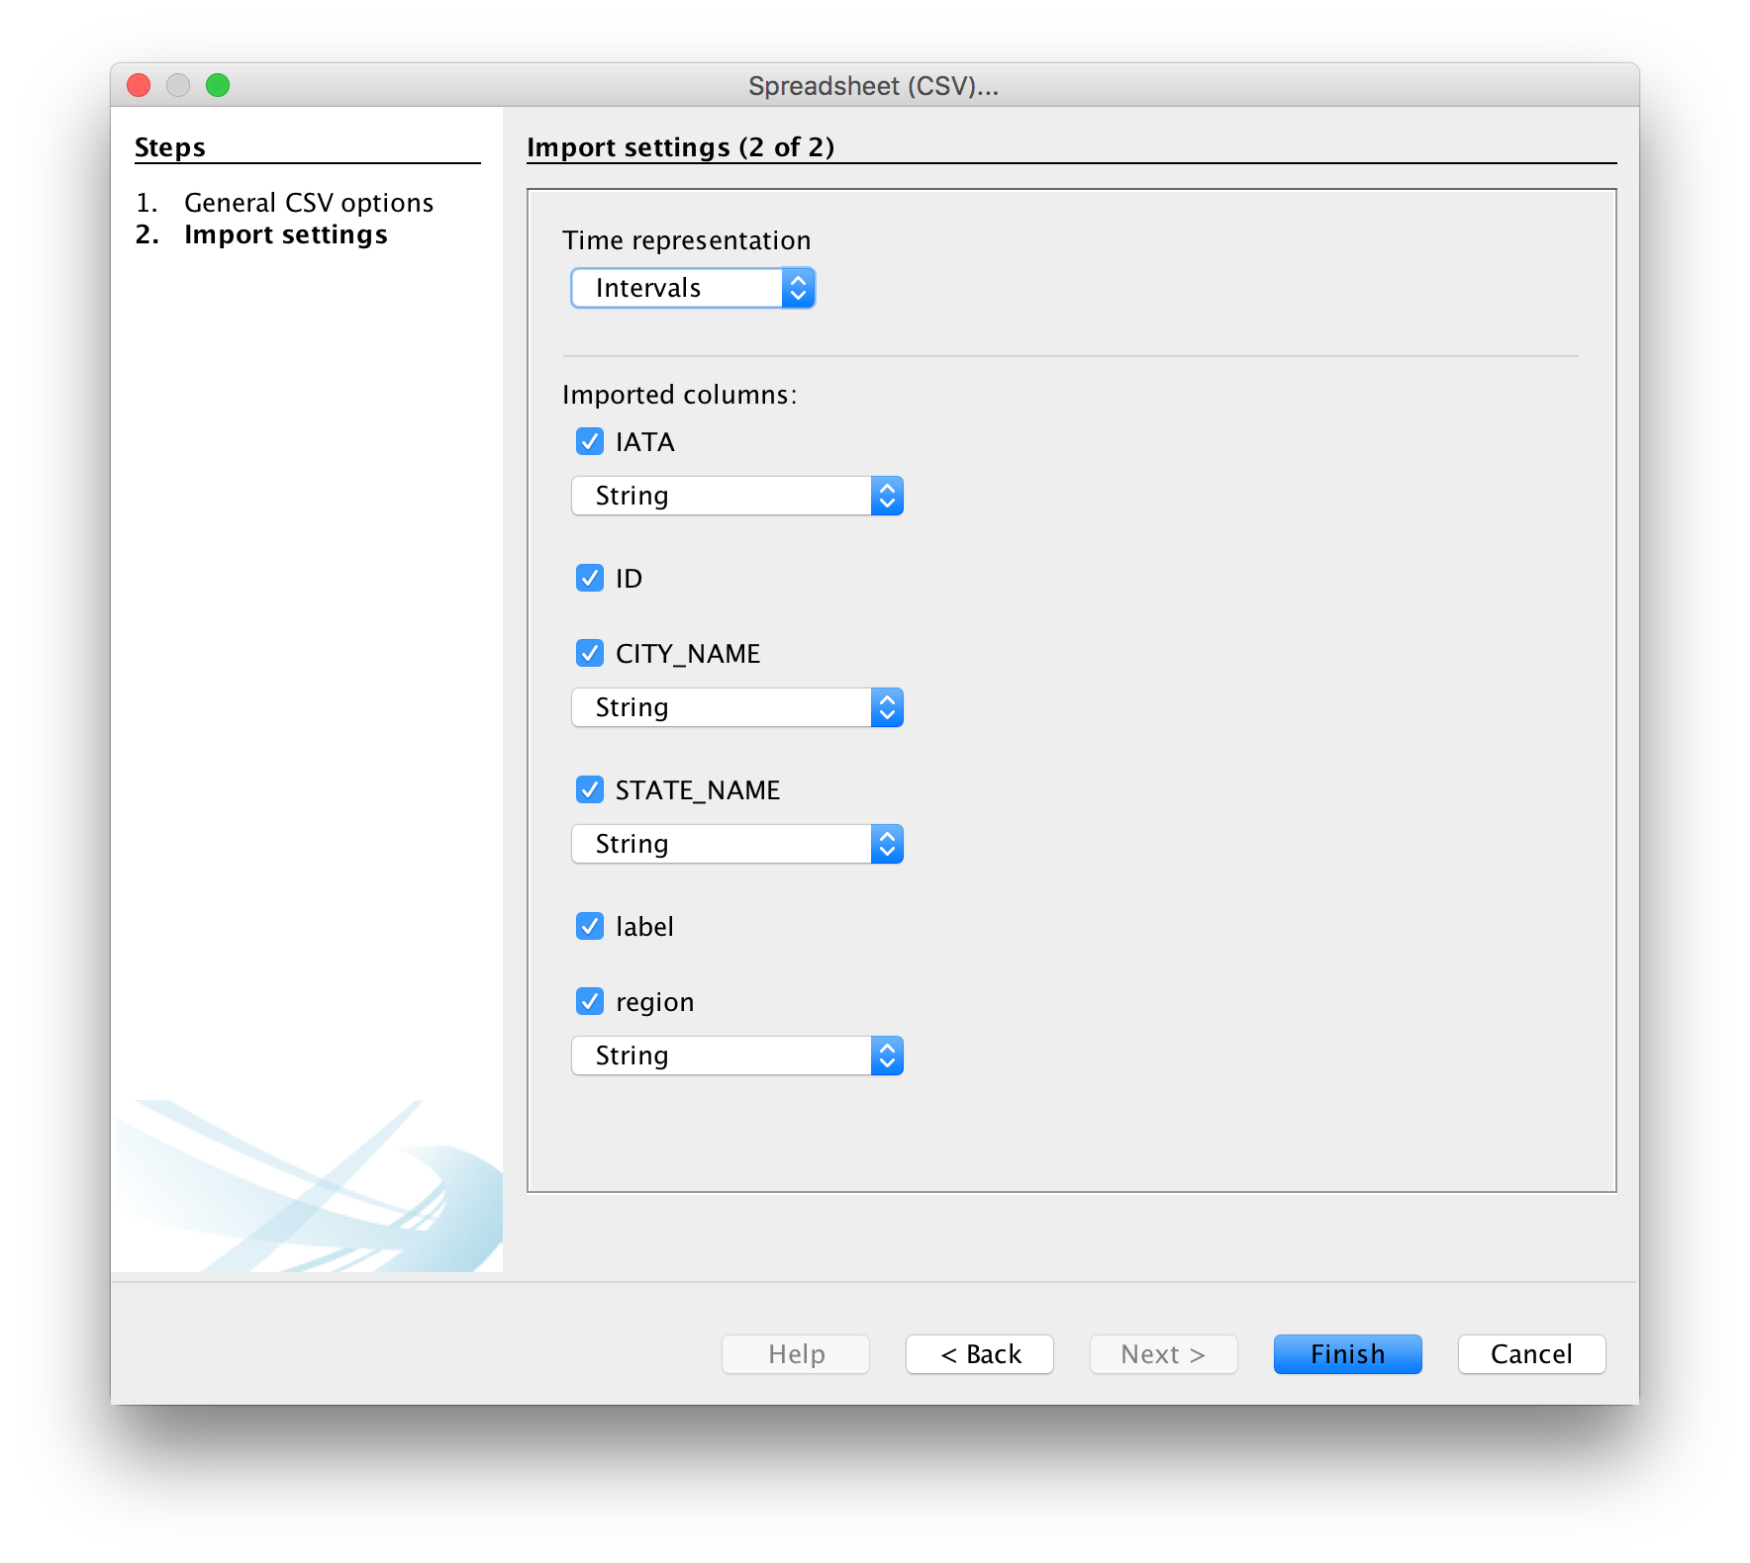
Notes:
We don't have time data, so we don't need to care about intervals
Check your data types. "String" means text, "Double" means number because computers.
Notice that label and ID don't have those data types because gephi has default interpretations

Slide 13
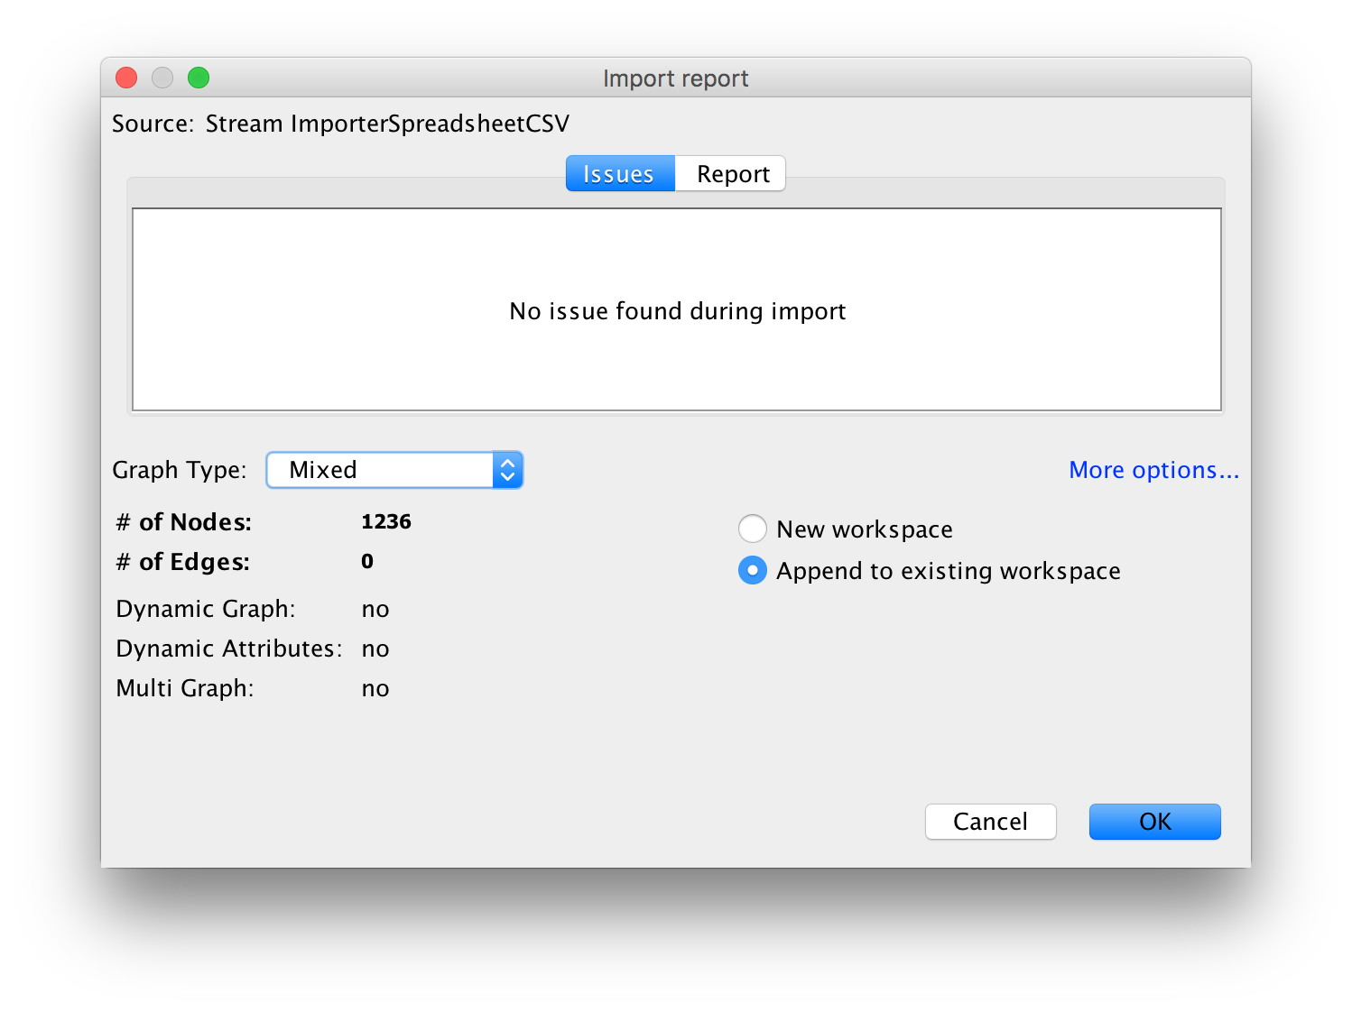
Notes:
Important to change selection to "append", otherwise you get a lot of different workspaces

Slide 14
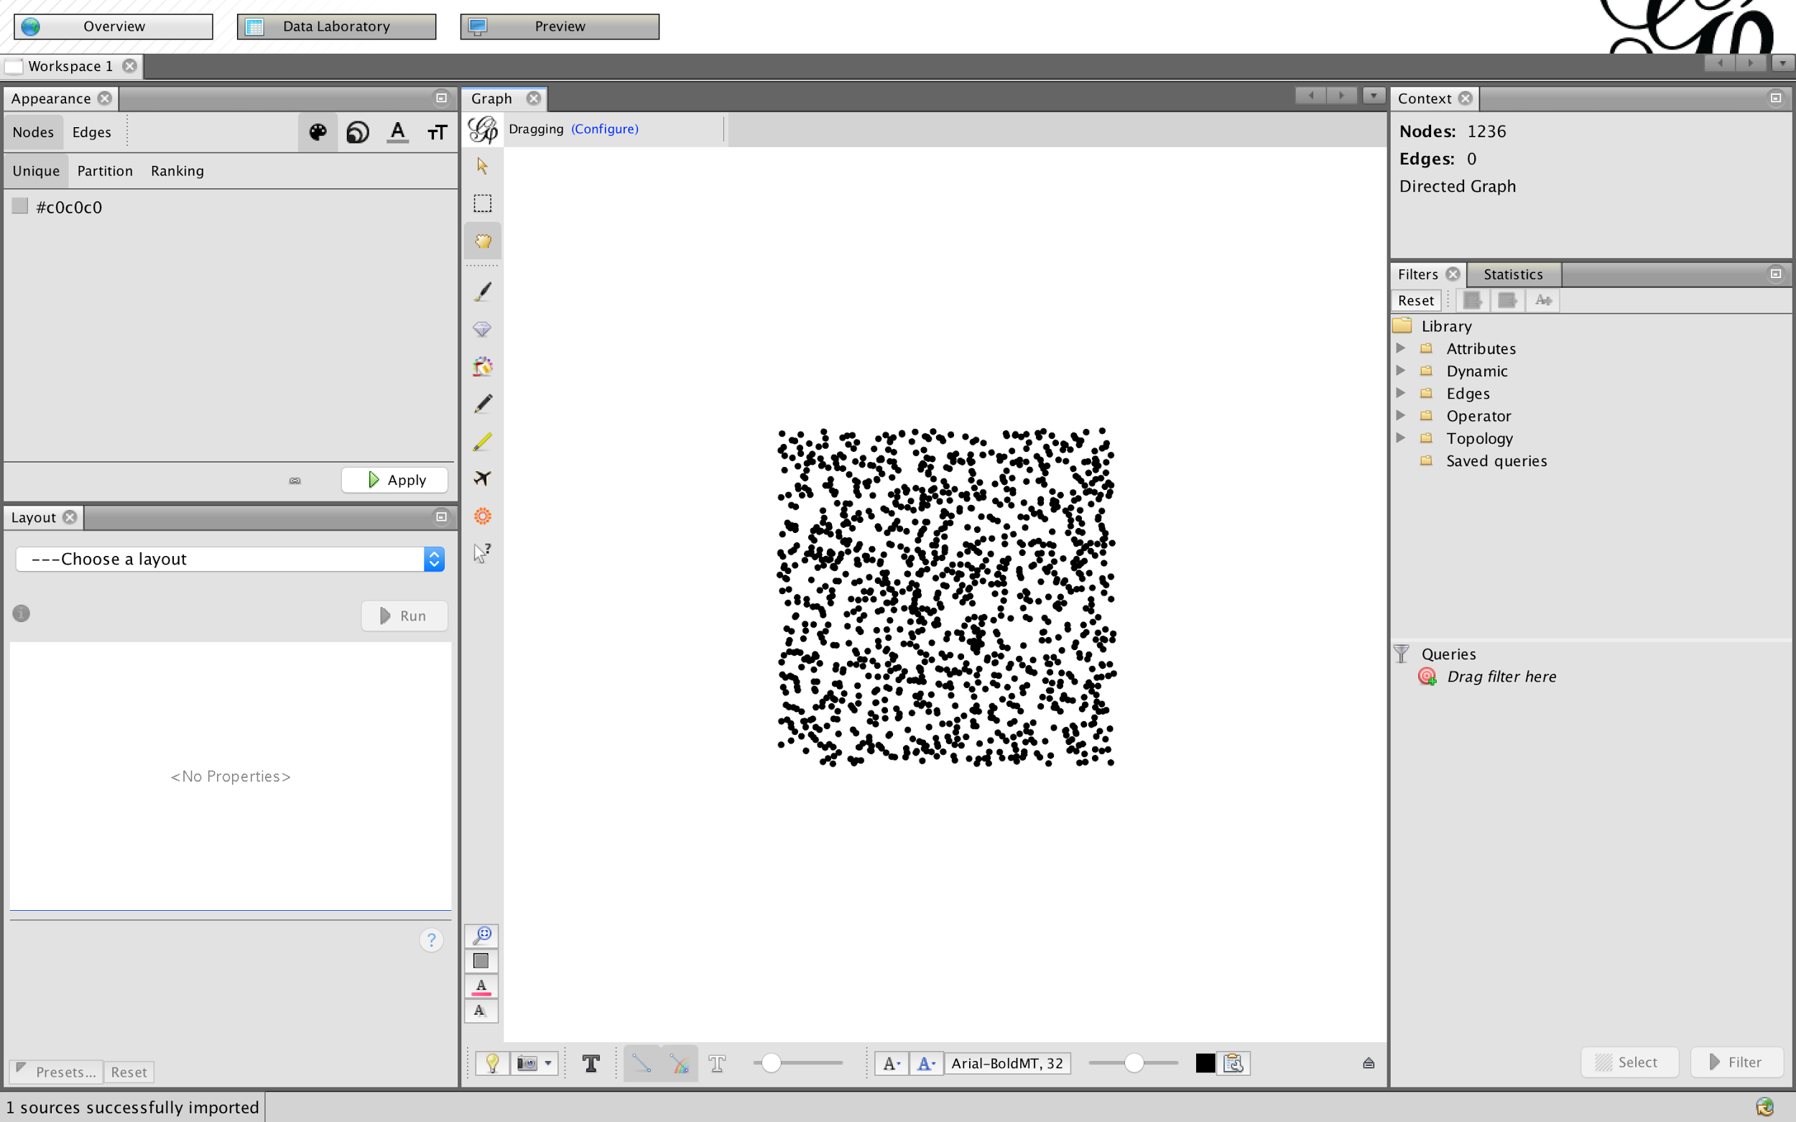
Notes:
Starts with random layout in square, position means nothing yet. Also no edges yet

Slide 15
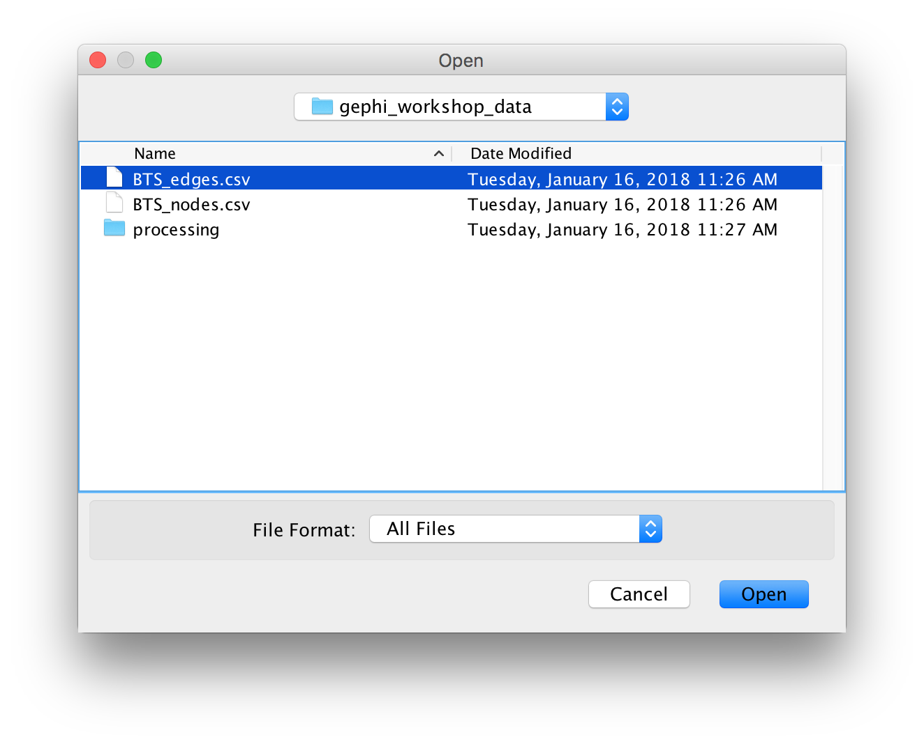

Slide 16
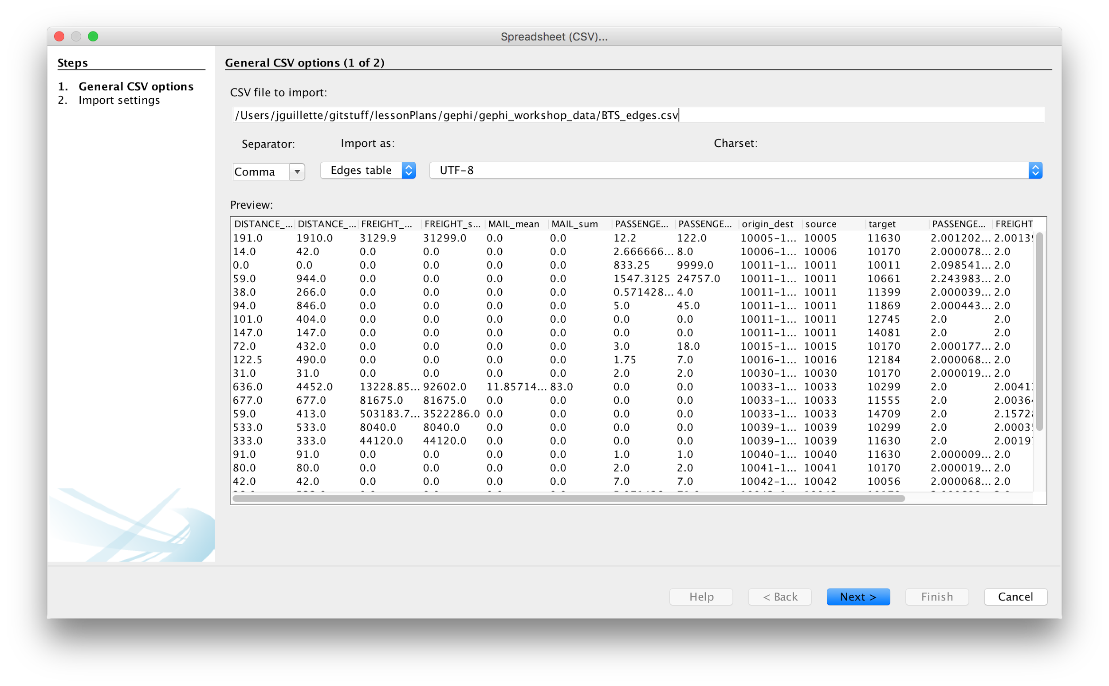
Notes:
Again, check separators, import type, and encoding for errors. If sheet looks good, click next

Slide 17
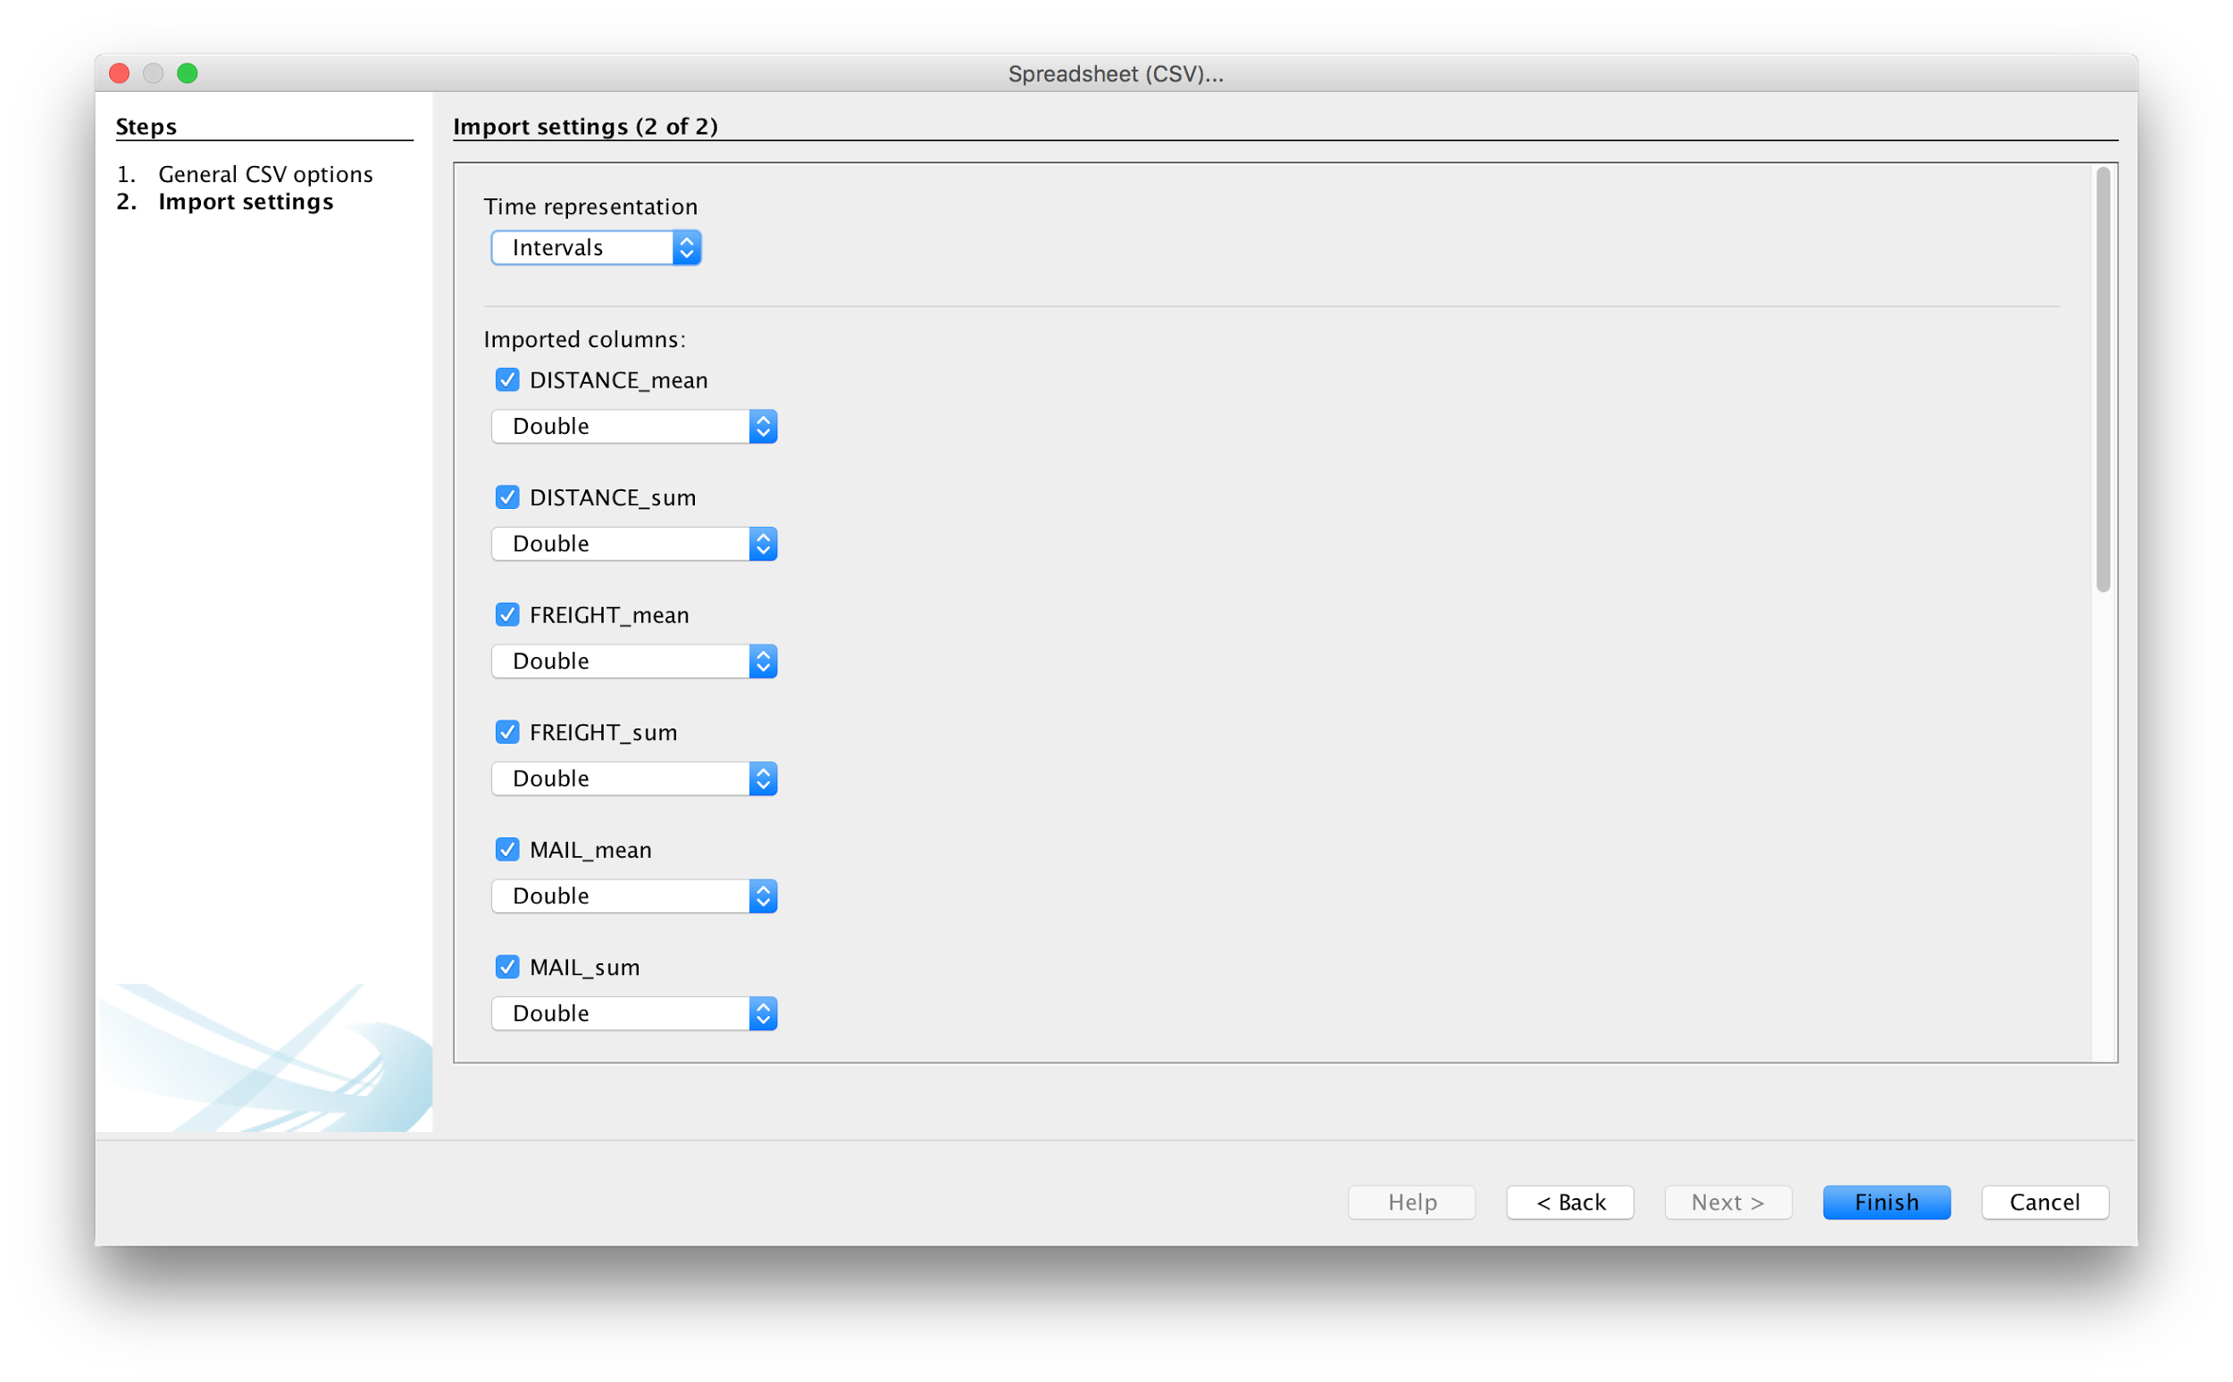
Notes:
Check data types. Remember, string=text, double=number because Java

Slide 18

Notes:
Don't forget, especially in this import, because otherwise you've disconnected nodes from edges

Slide 19
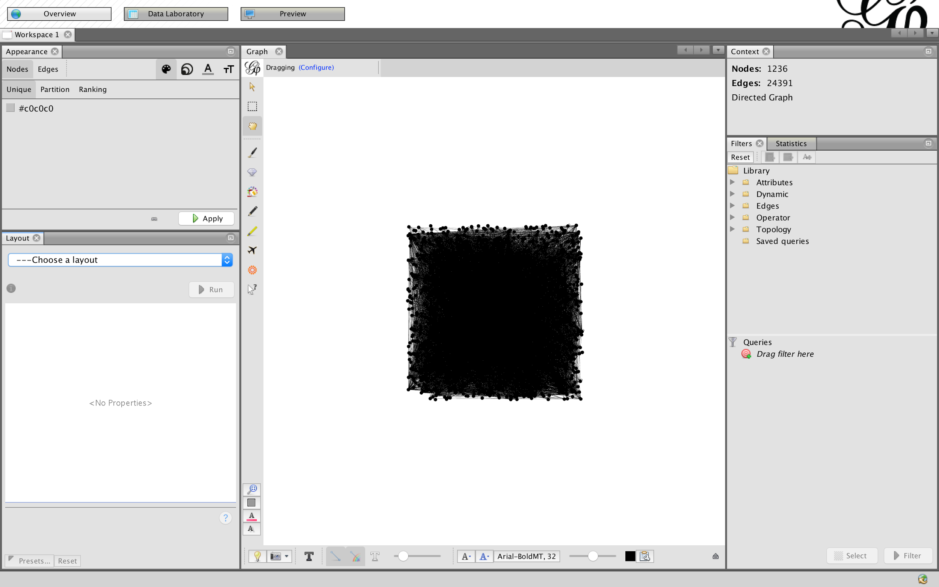
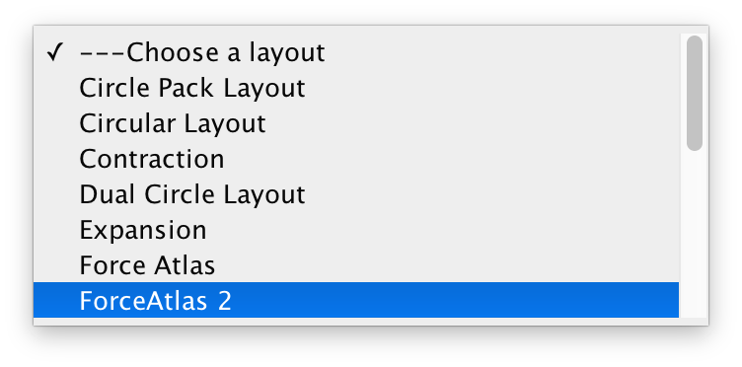
Notes:
Still random layout, now connected. Very dense, position means nothing, unreadable. Let's do a new layout.

Slide 20
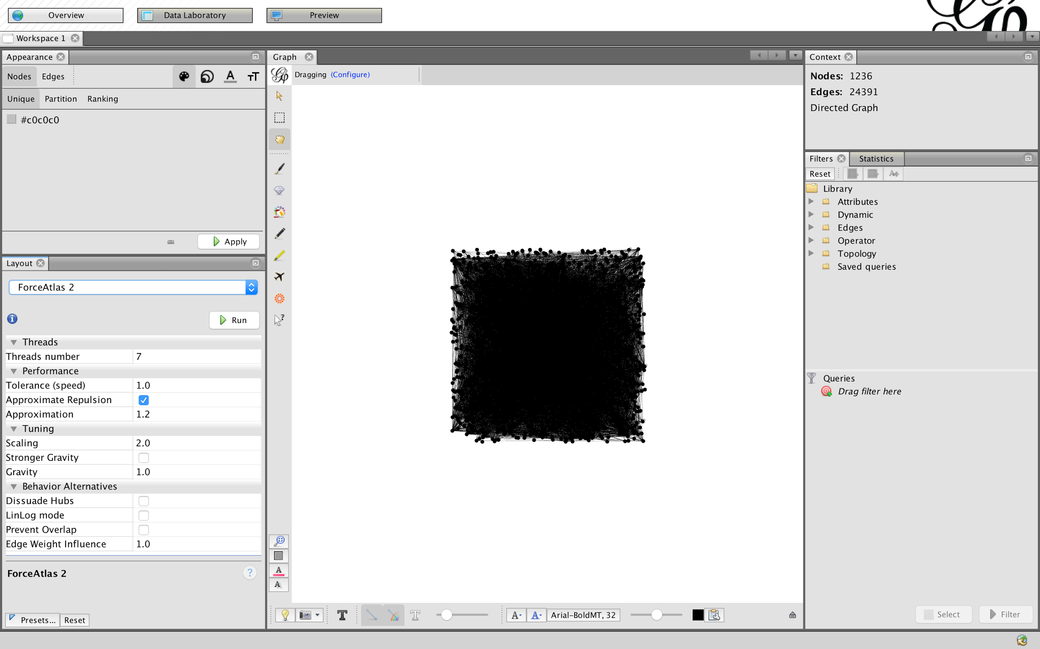
Notes:
Force atlas 2 is a layout that simulates a physical interaction between nodes and edges, the most common way of displaying this kind of graph. Nodes repel each other, except along edges, which attract each other.

Slide 21
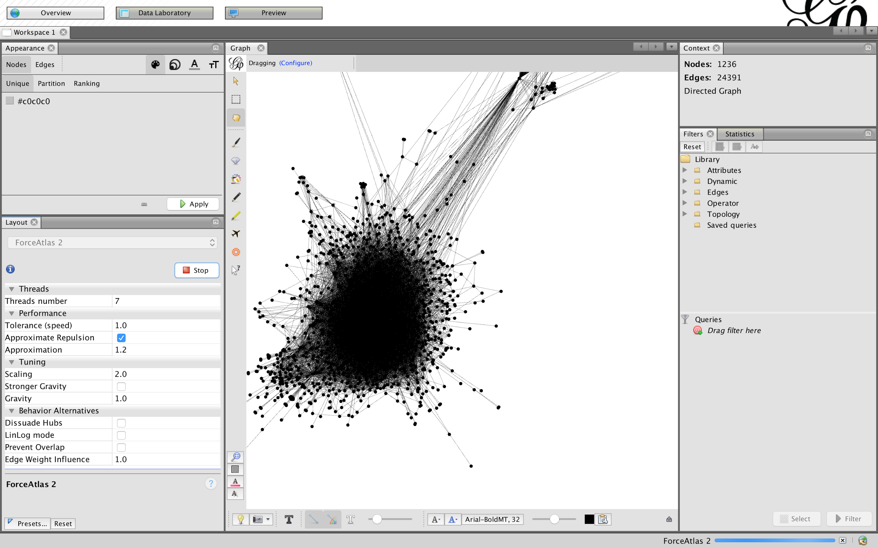
Notes:
It'll move around a whole bunch, but when things settle down, you can click "Stop" to stop the physical simulation

Slide 22
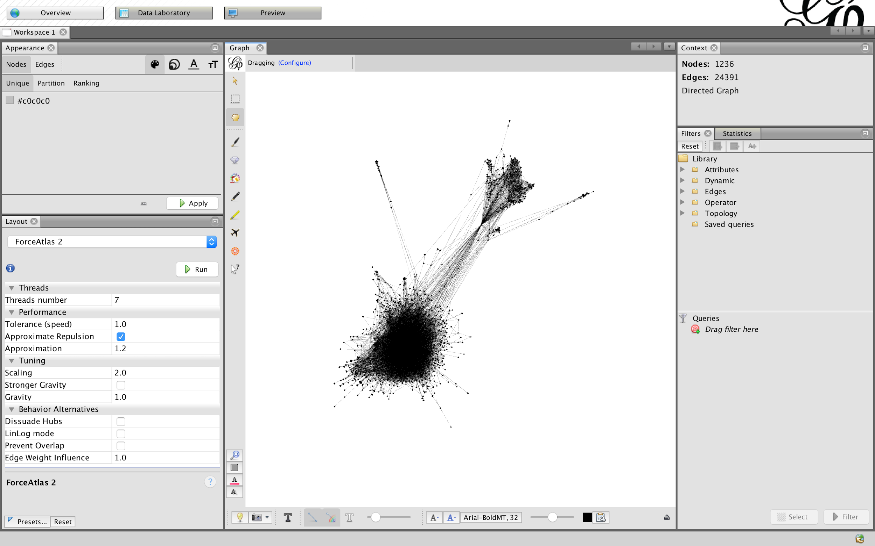
Notes:
Zoom in and out with a scroll wheel or gesture, and pan with right-click + drag, so you can see the network

Slide 23
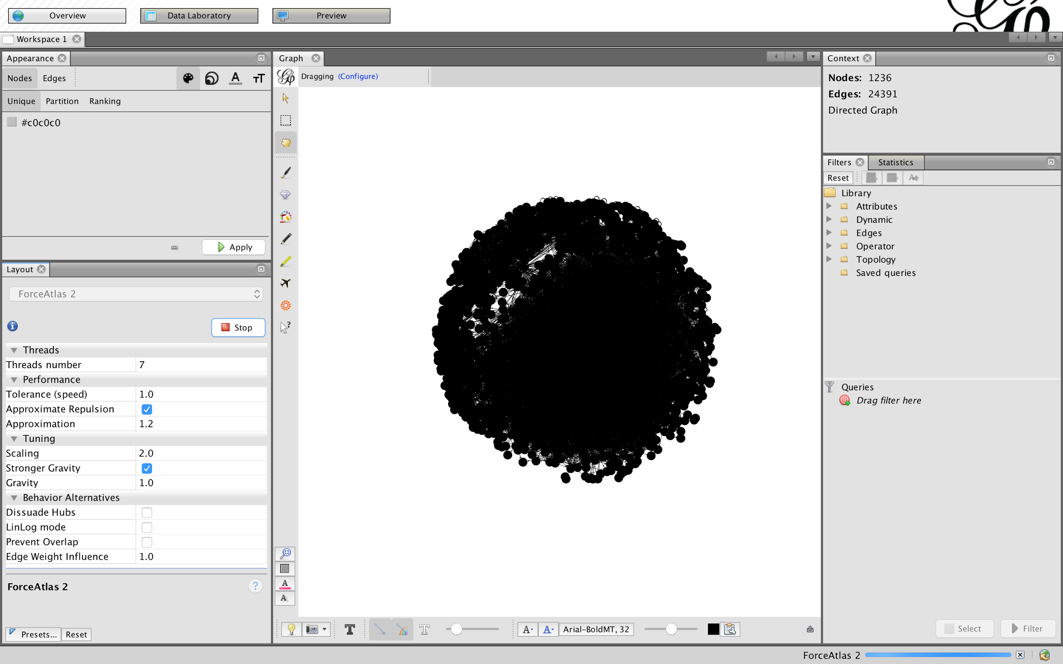
Notes:
Stronger gravity pulls in outliers, but the default gravity is really strong, so you wind up with a circle that you can't read.

Slide 24
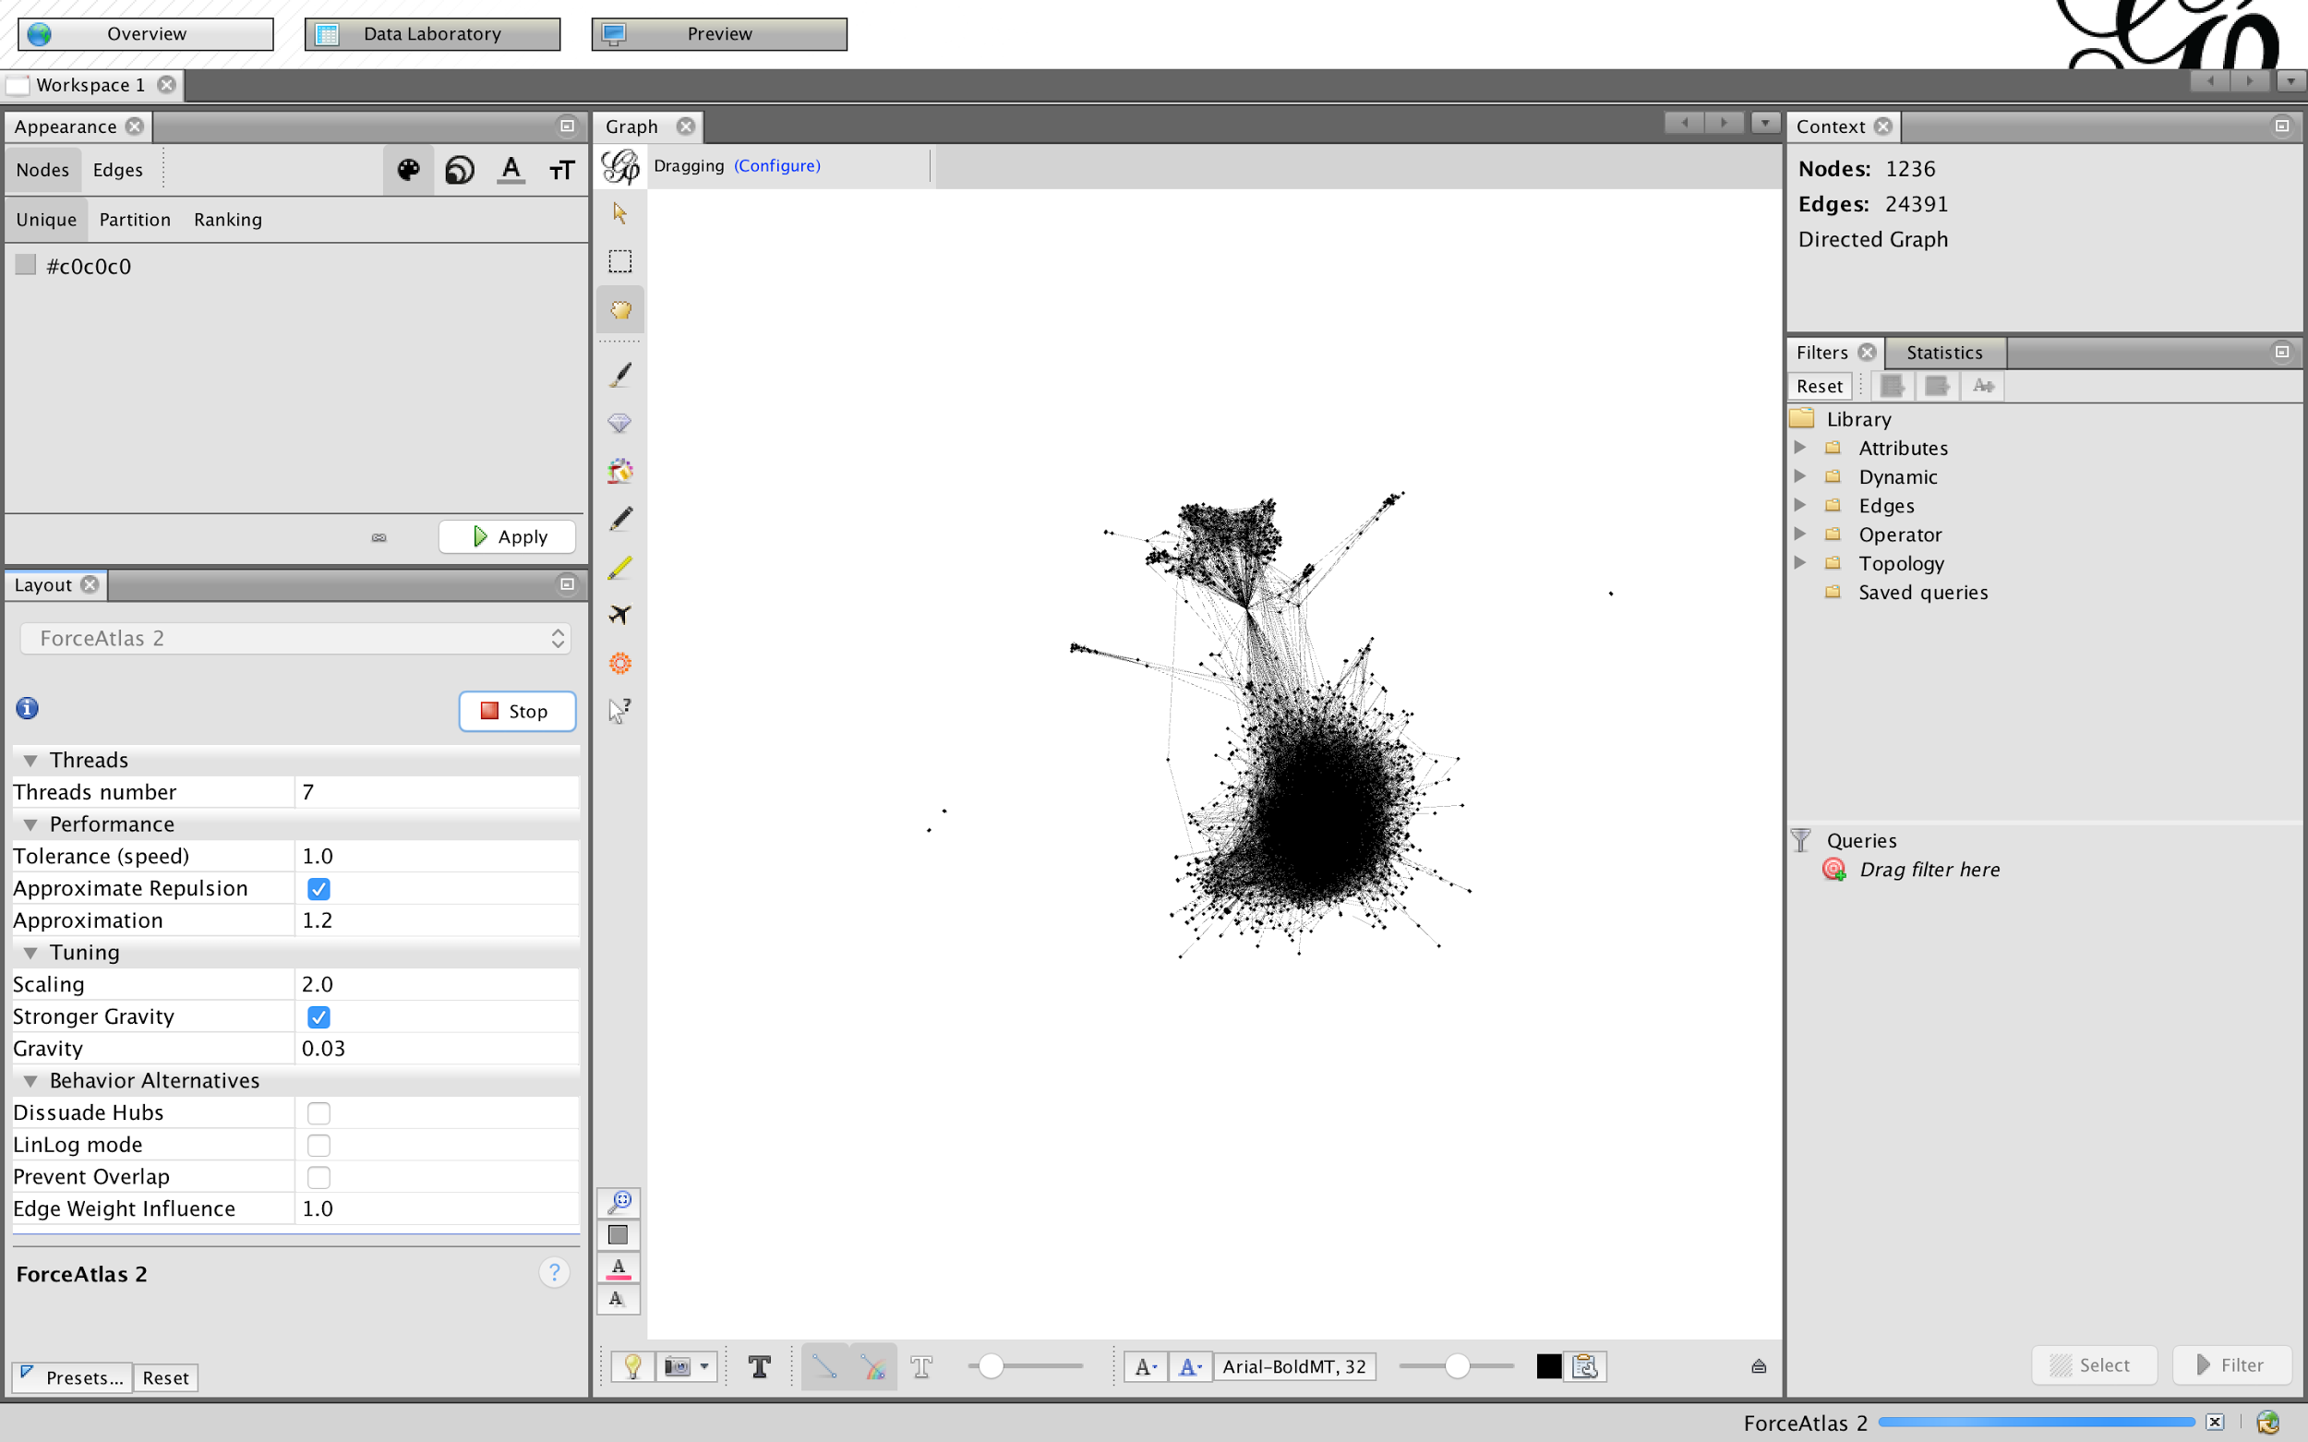
Notes:
Turning the gravity way down restores our original shape, but we can see that some wayward nodes have come back into the fold

Slide 25
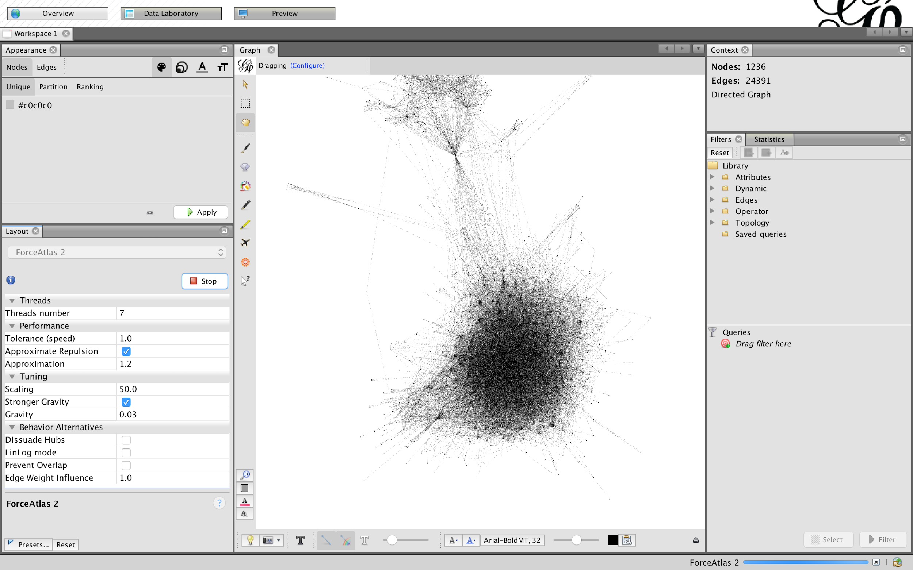
Notes:
Changing the scaling gives us more space to play with node size, which we can do now. But play with the settings on your own, take a look at the documentation. These are the most useful ones, I've found, but there are lots

Slide 26
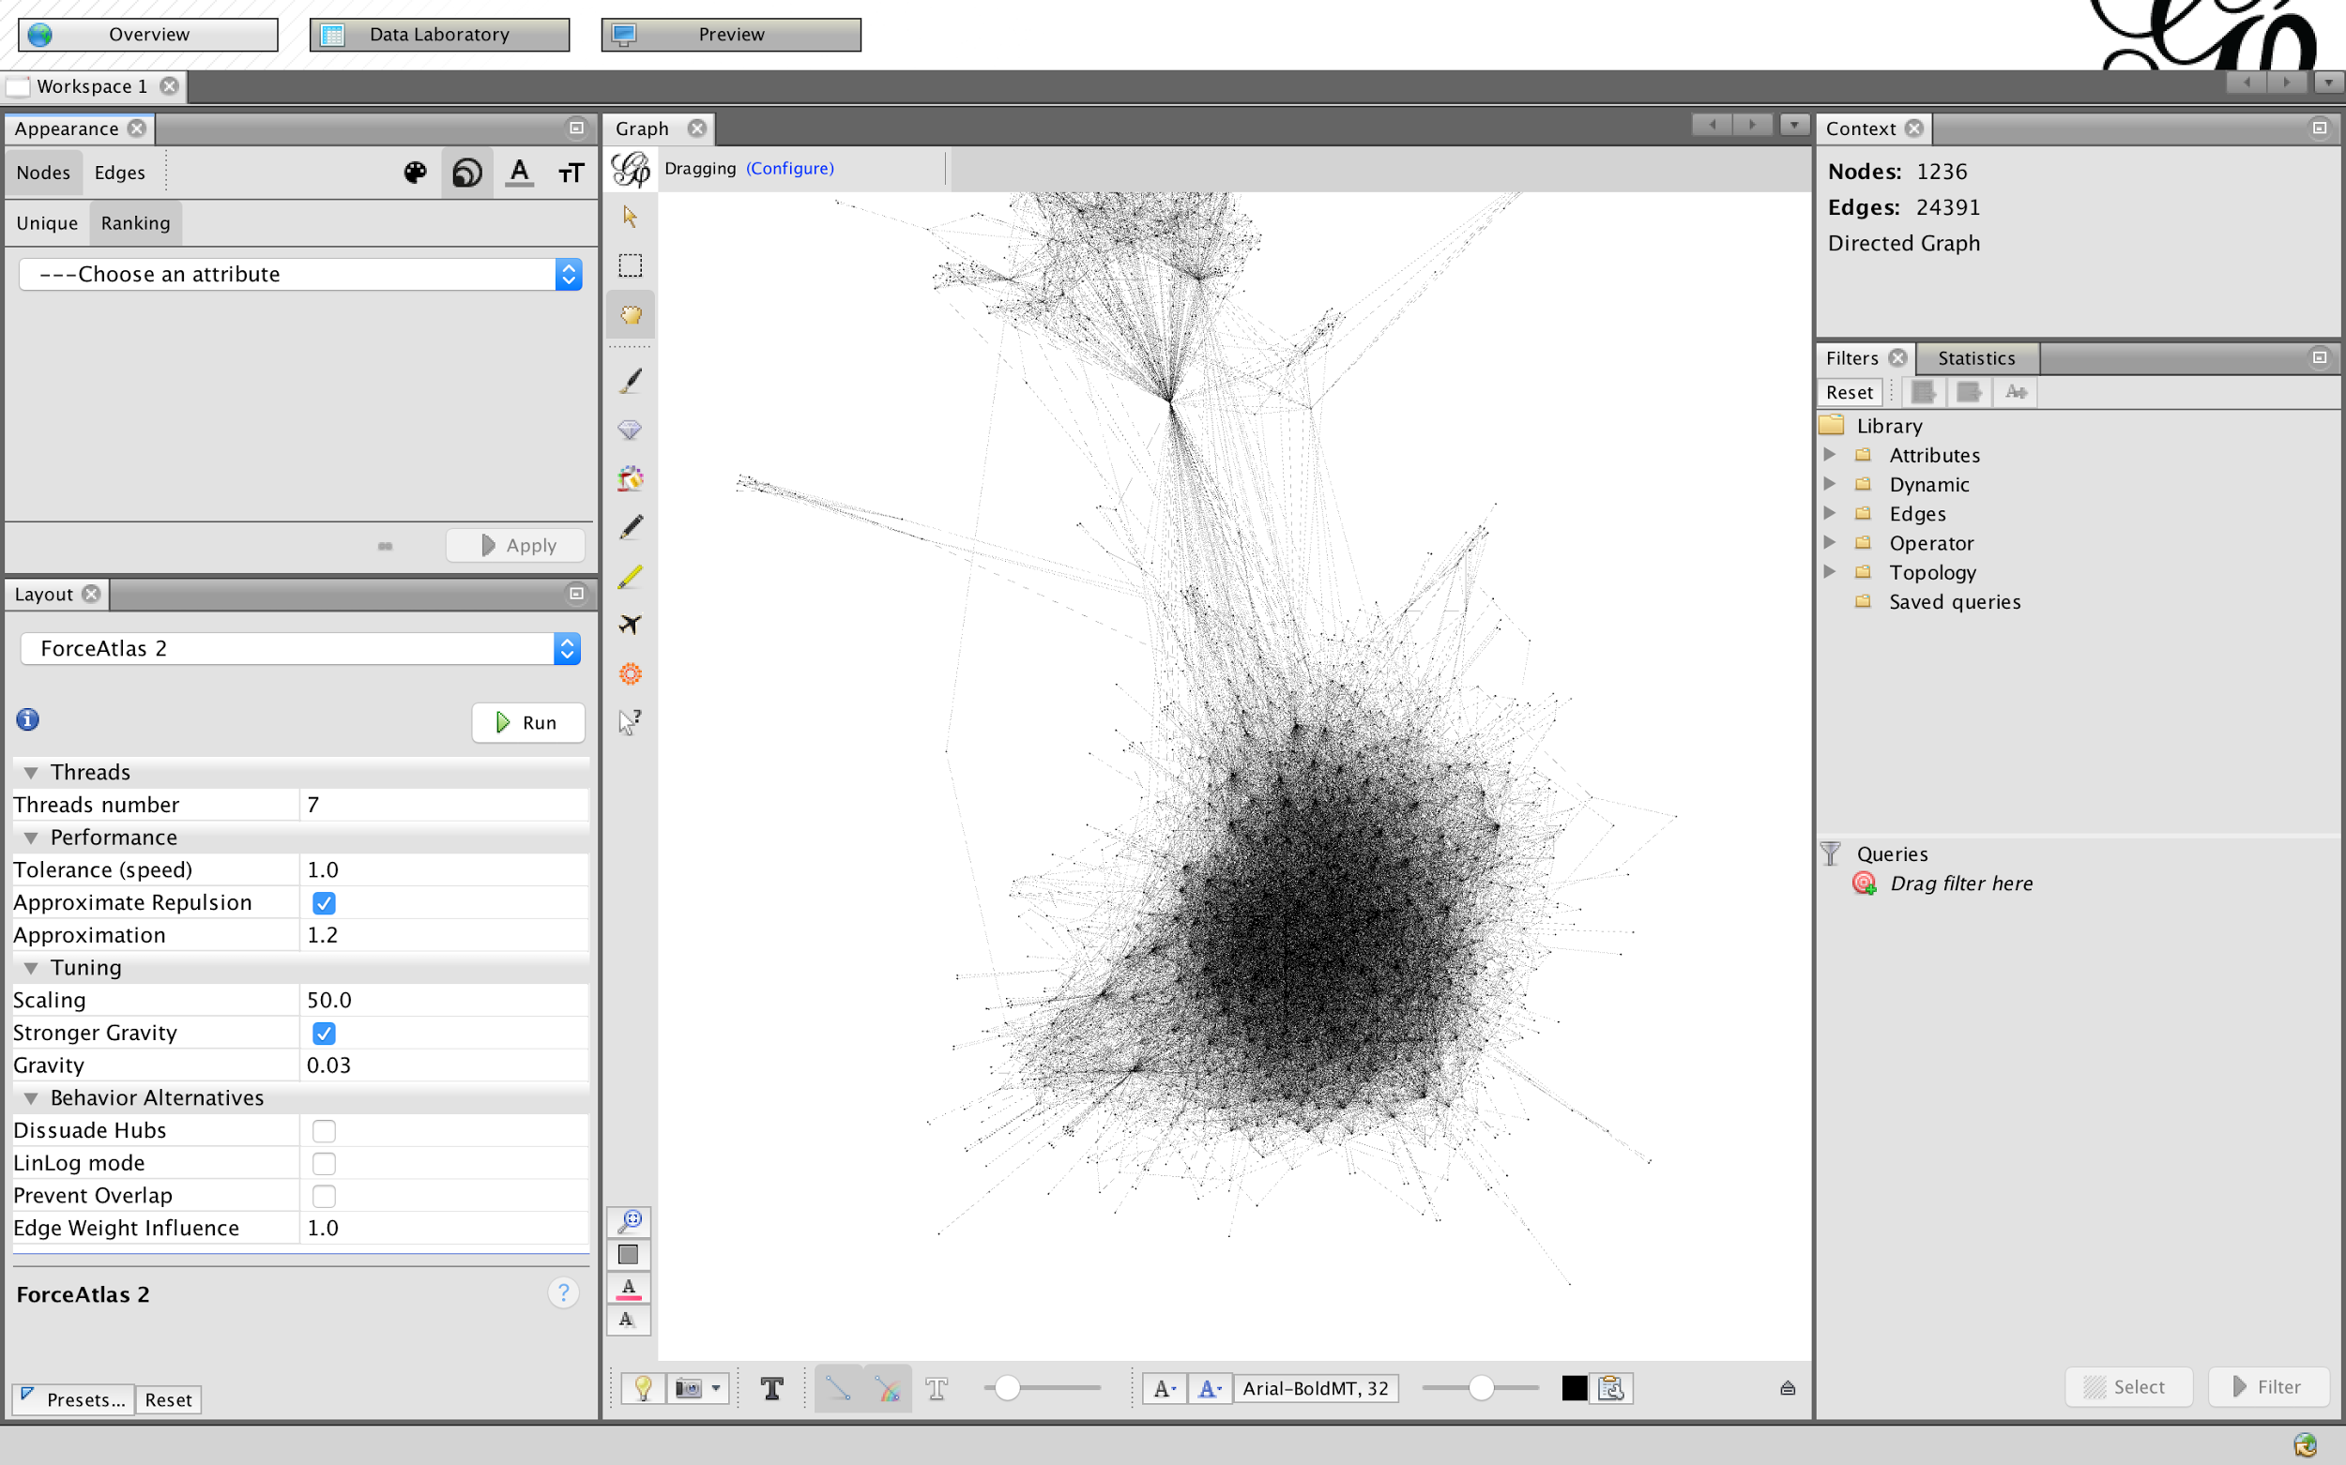
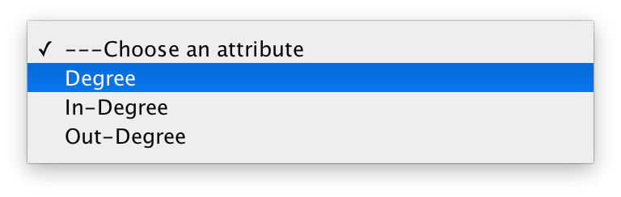
Notes:
We can re-size nodes based on numeric values with the "size" icon, then going to "ranking" for a scale. "Unique" lets you set a single size for every node
We didn't set any of these numbers on nodes, they are generated automatically. "Degree" means the number of edges, regardless of direction (remember we had origins and destinations for all data, so we have a directed graph). In-degree means incoming edges, out-degree means outgoing edges.

Slide 27
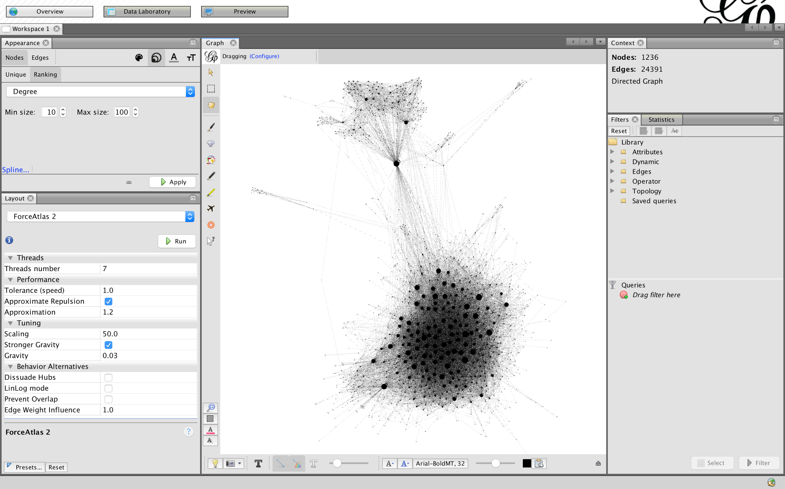
Notes:
You get a scale of sizes, a min and max, and then you apply the sizes to the graph. Ta-da! Nodes sized by number of connections!

Slide 28
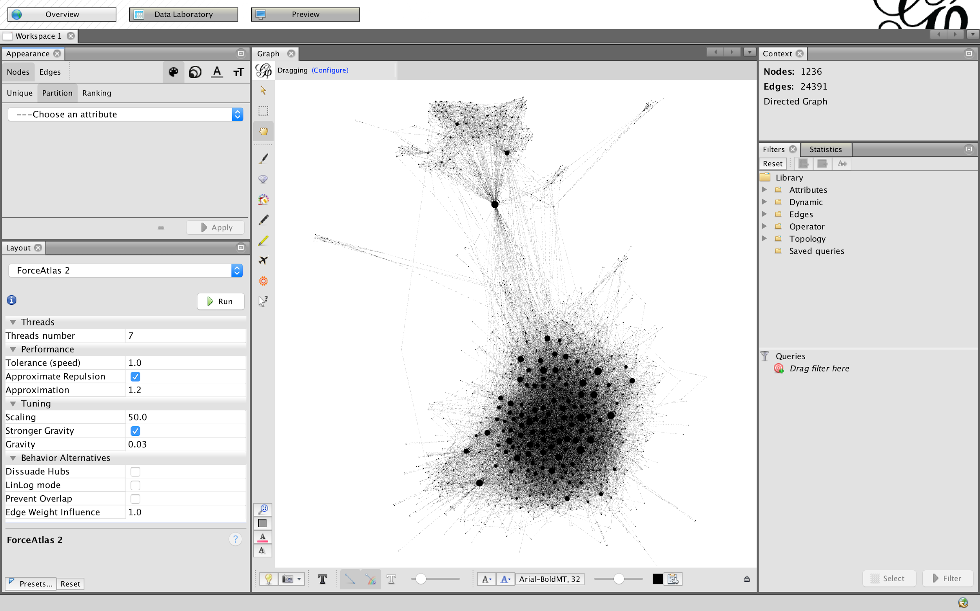
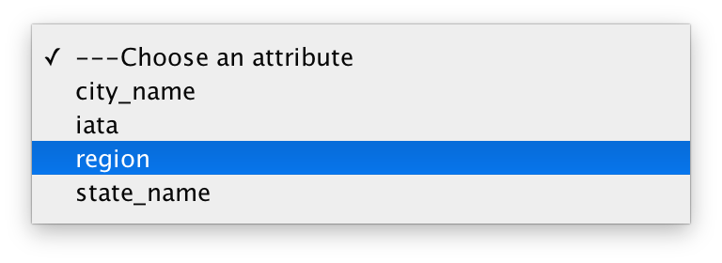
Notes:
Now we can change the color of nodes. To see options, go palette, then "Partition" for categorical variables (no continuous scale from Alabama to Wyoming). Palette generated automatically, but modifiable.

Slide 29
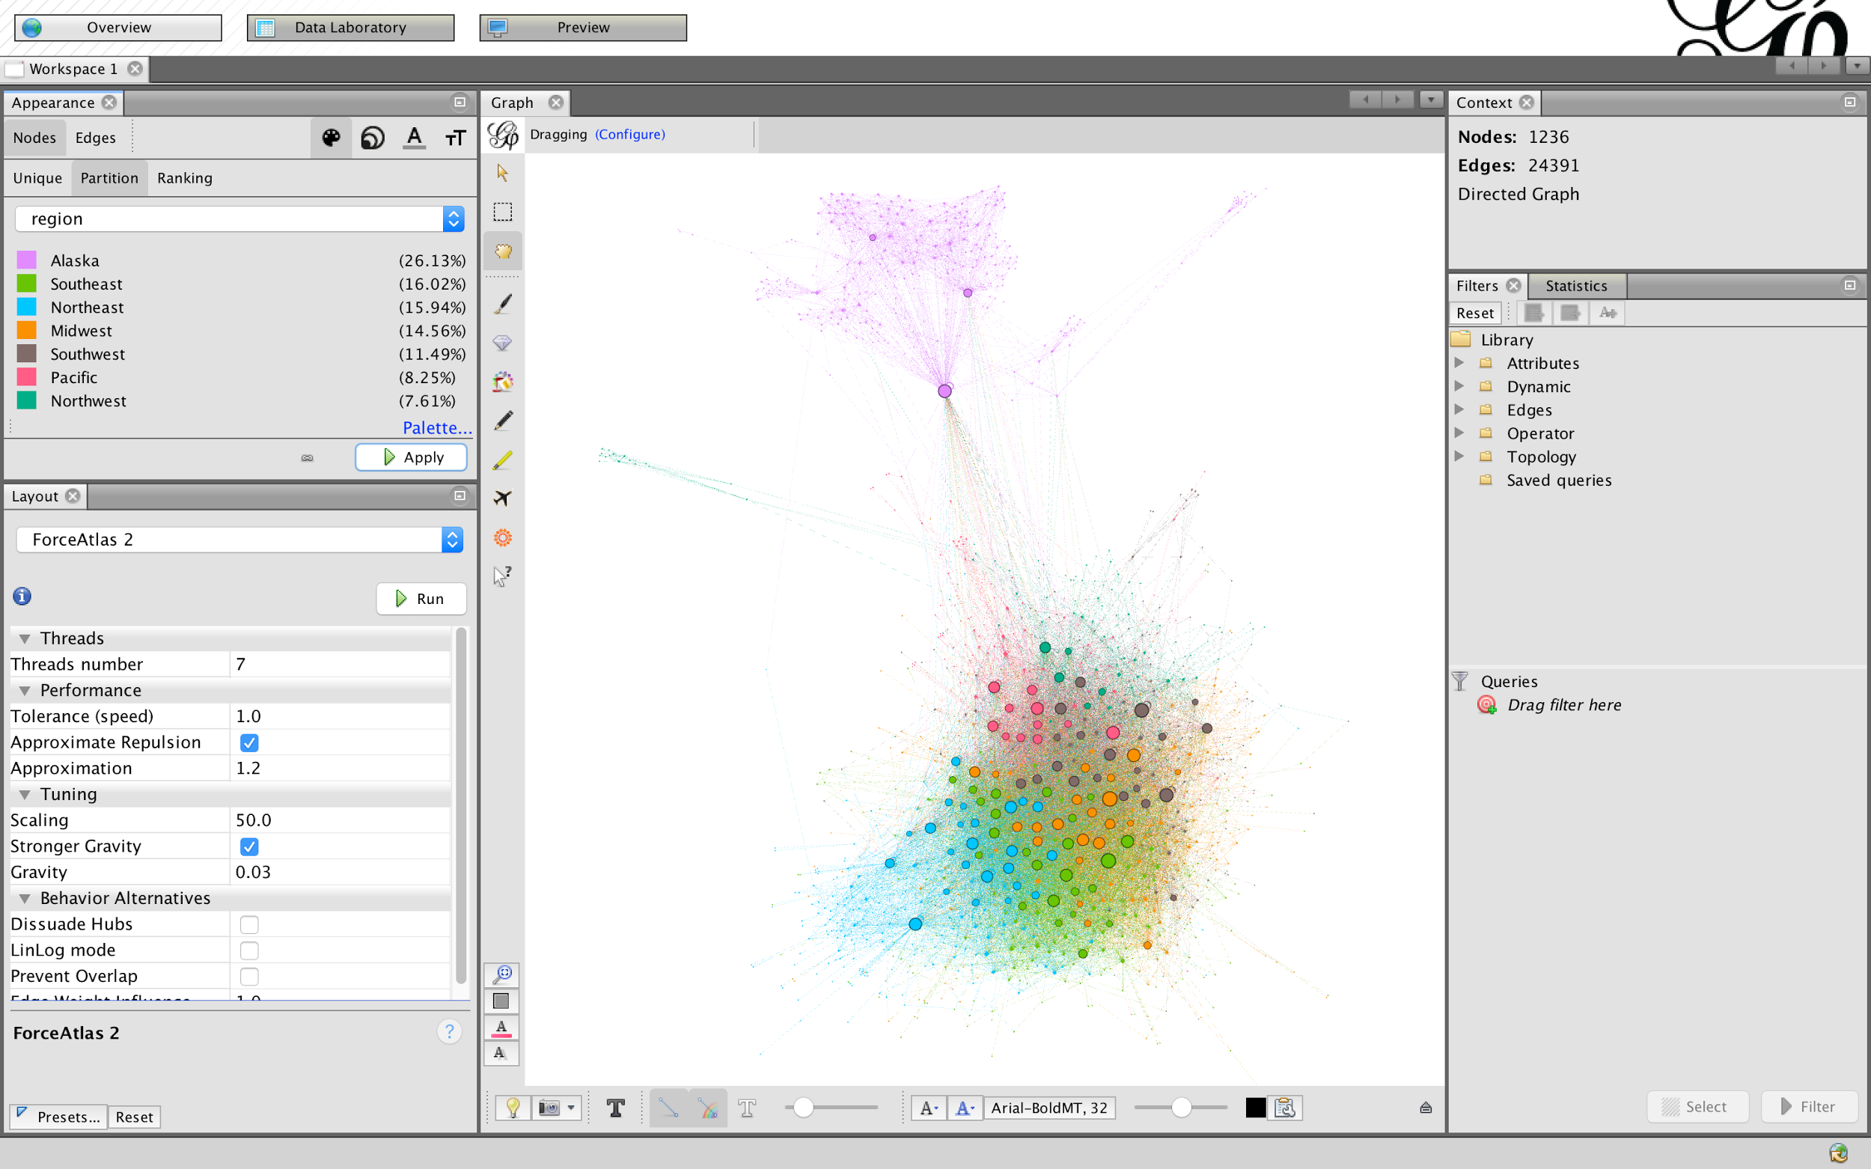
Notes:
Check palette and click apply to see results

Slide 30
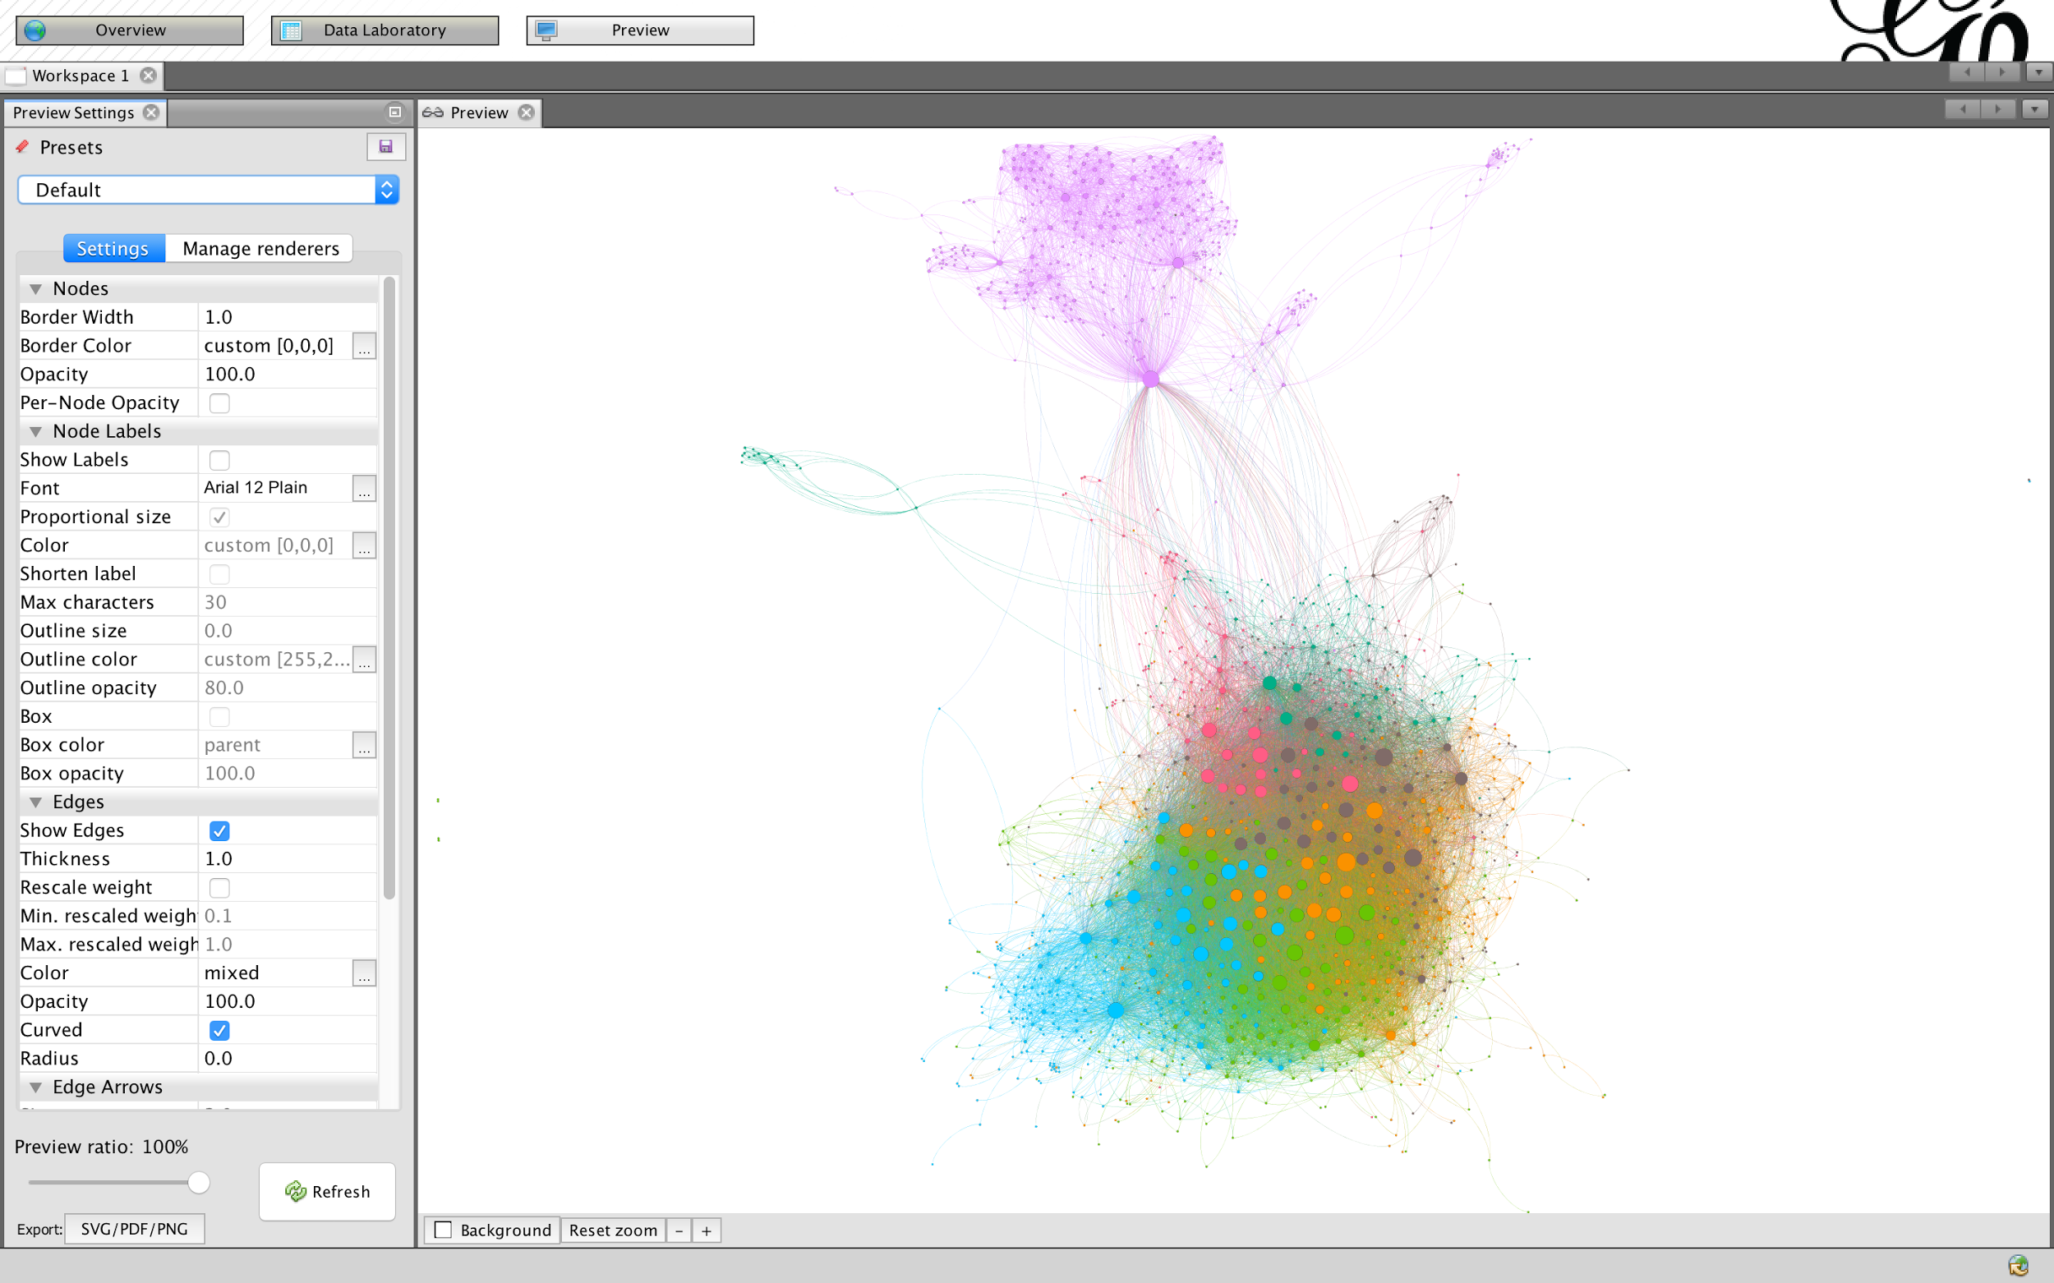
Notes:
Perfectly exportable now, a logical depiction of connections between airports in the US that sent planes to each other at some point in 2016. Go to preview, then refresh to see your graph. You can change all of these rendering options, and export to svg (illustrator, etc.) pdf, or png (static image)
Can also save project as gexf and use a js renderer for an online, interactive viz
However, this is just a network visualization. We haven't done much network analysis.

Slide 31
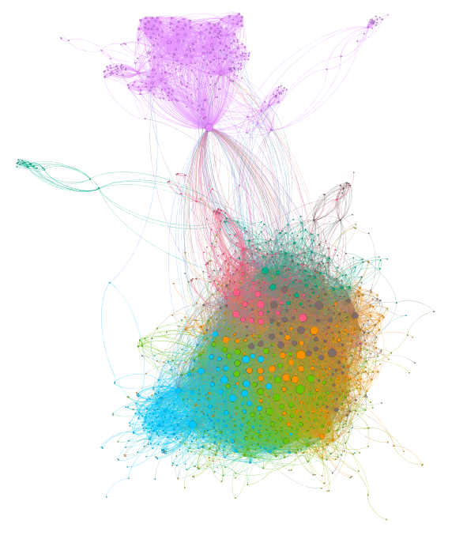
Notes:
There we have it, technically a network visualization. However, it's really fuzzy looking and hard to read, so let's see if we can trim it a bit with some filters

Slide 32
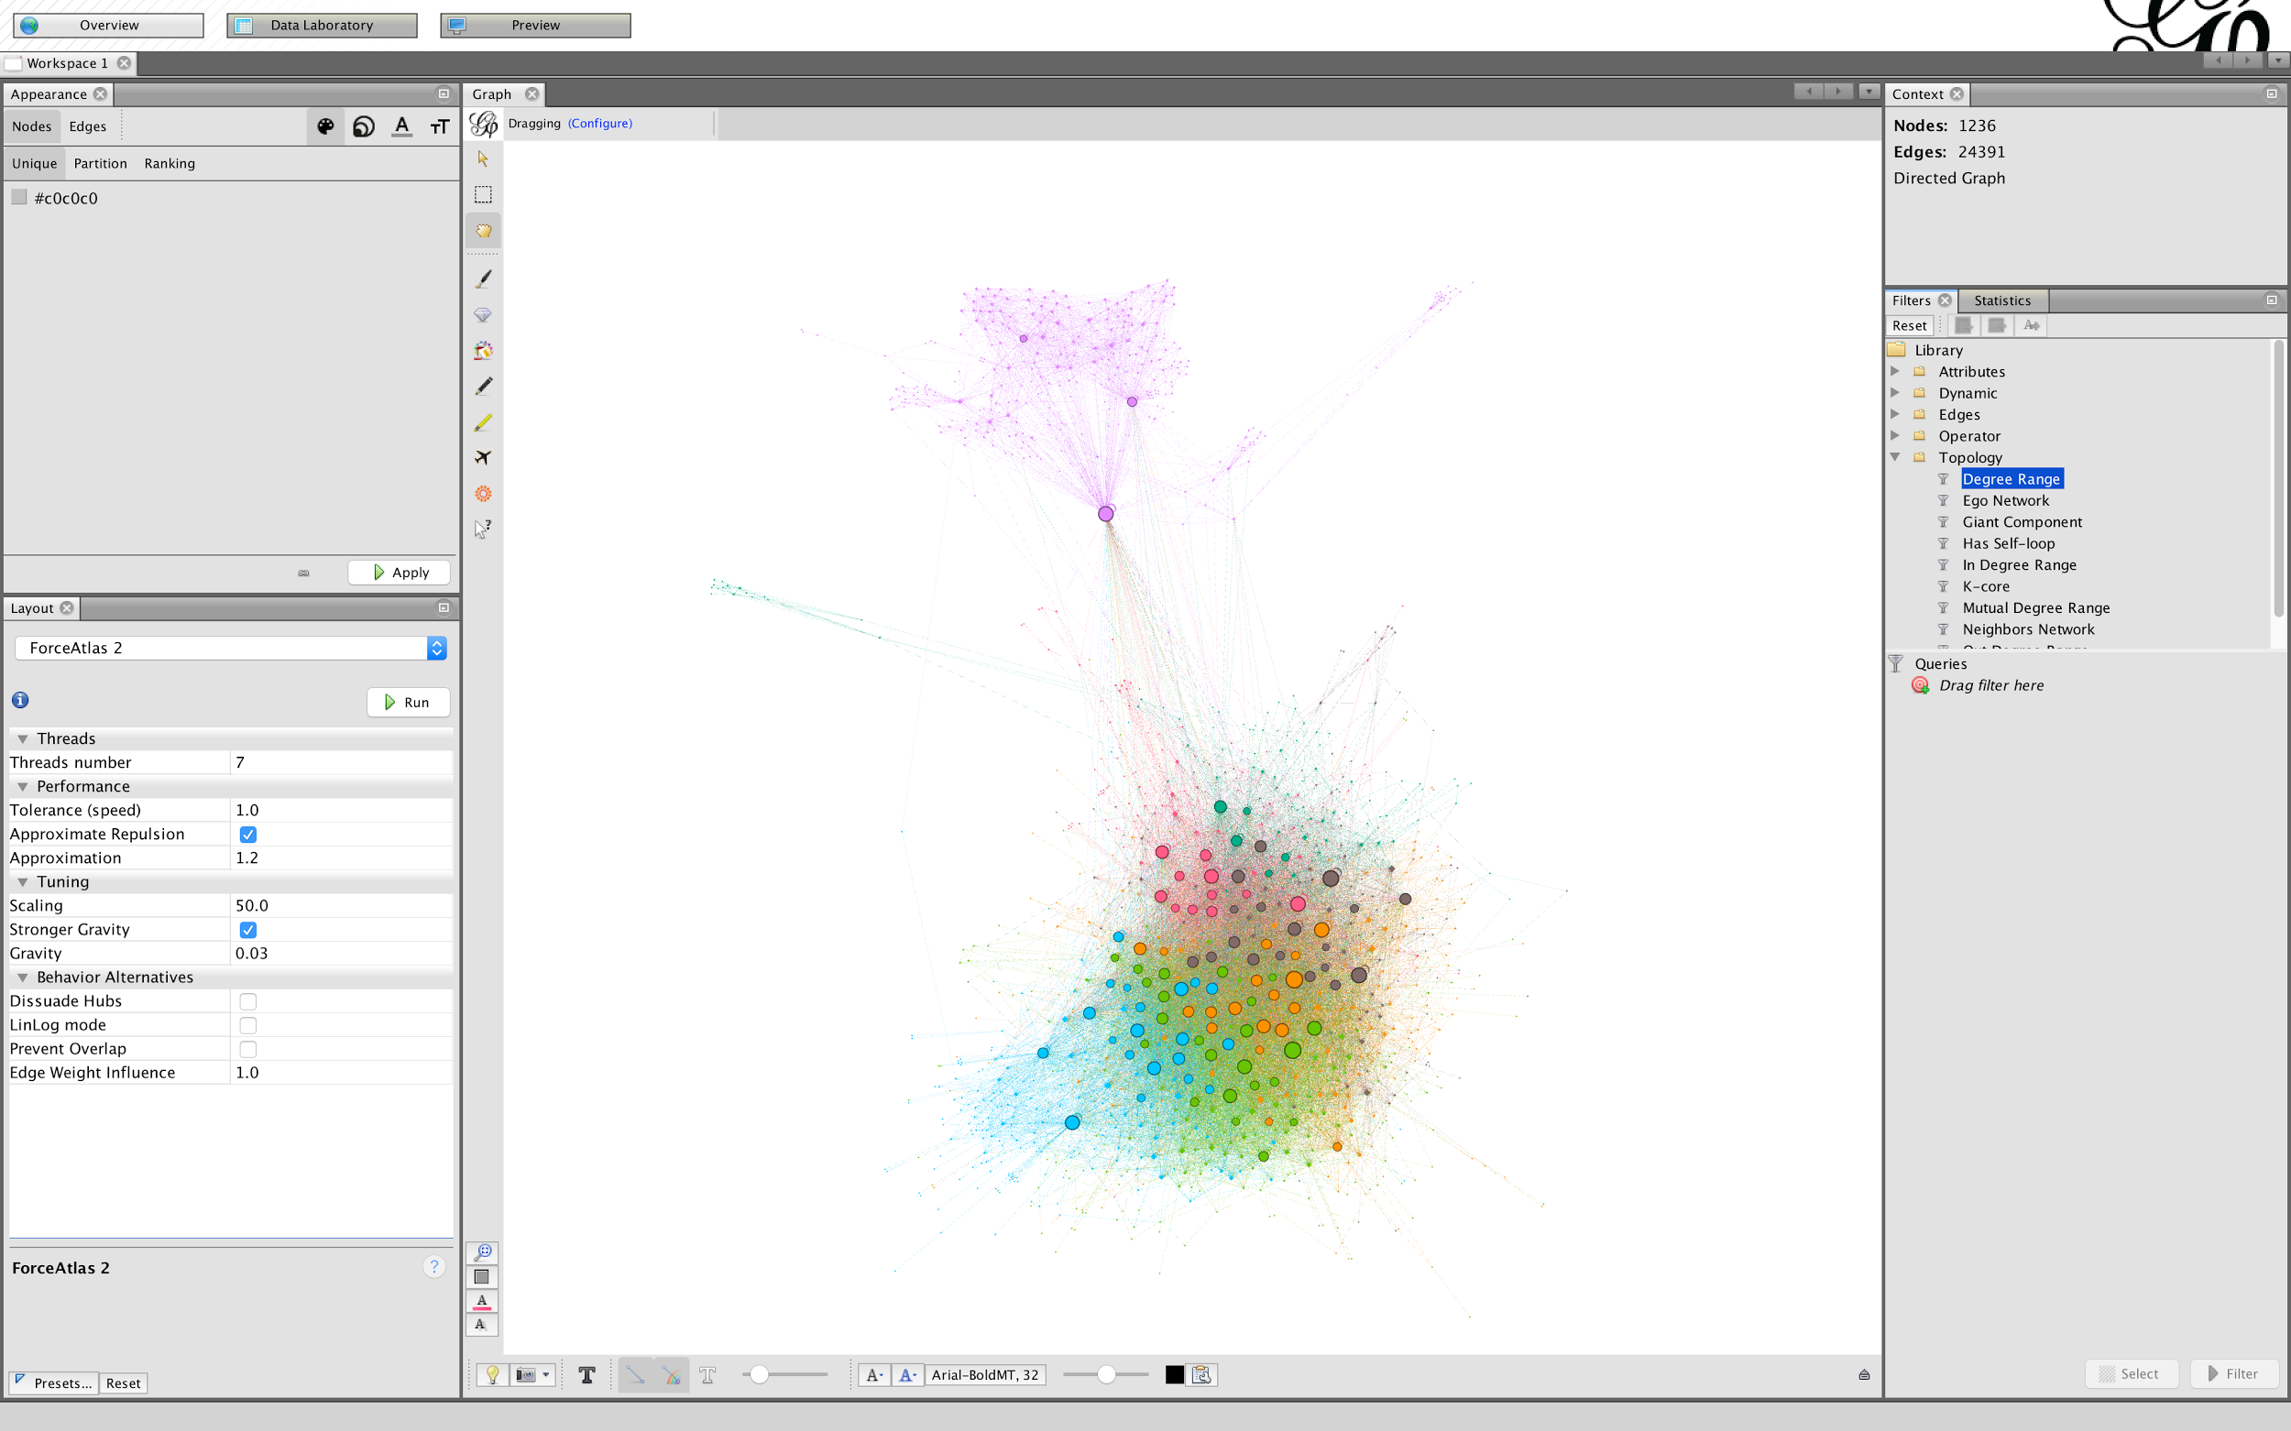
Notes:
We'll go back to overview, then to the filters tab on the right, then we'll open up "Topology" and select Degree Range, then drag it on to "drag filter here"

Slide 33
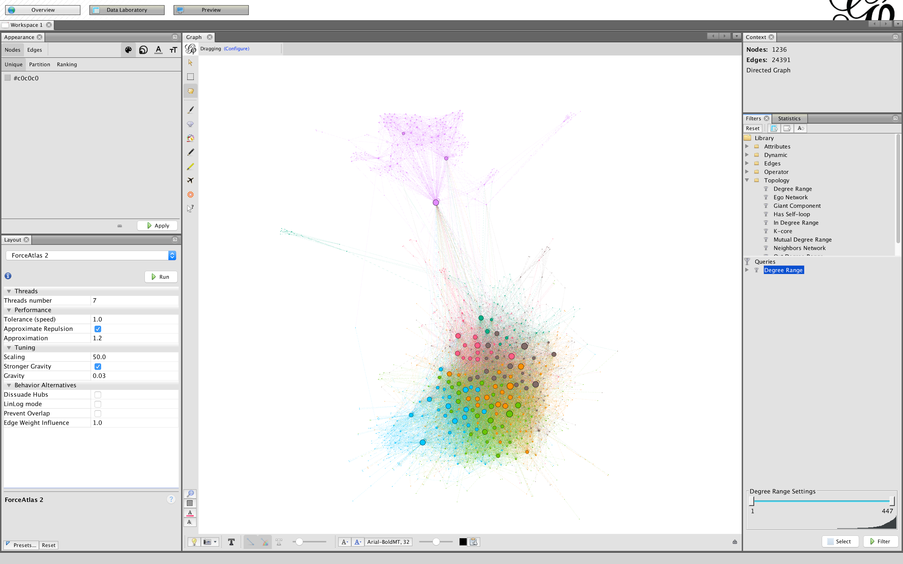
Notes:
You see that there's a range of degrees that will get filtered out at the bottom. What this will do is filter out nodes that have fewer than a certain number of connections. You can click and drag, or double click a number to change the numbers.

Slide 34
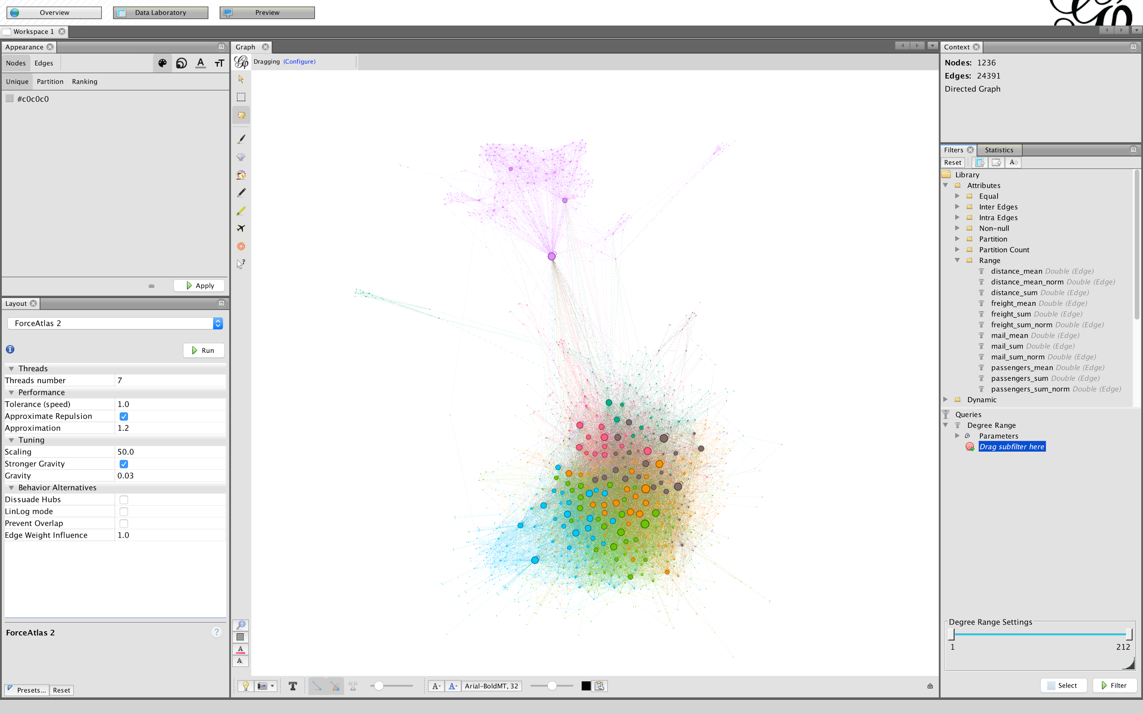
Notes:
But we're not just going to filter out outlier airports, we want a more complex filter. Filter hierarchy is a bit weird, nested filters get applied before their parent filters, so we can filter out edges by a criterion, and then remove nodes that have no connections after that filter, so we can look at airports that have pretty large numbers of passengers, say...

Slide 35
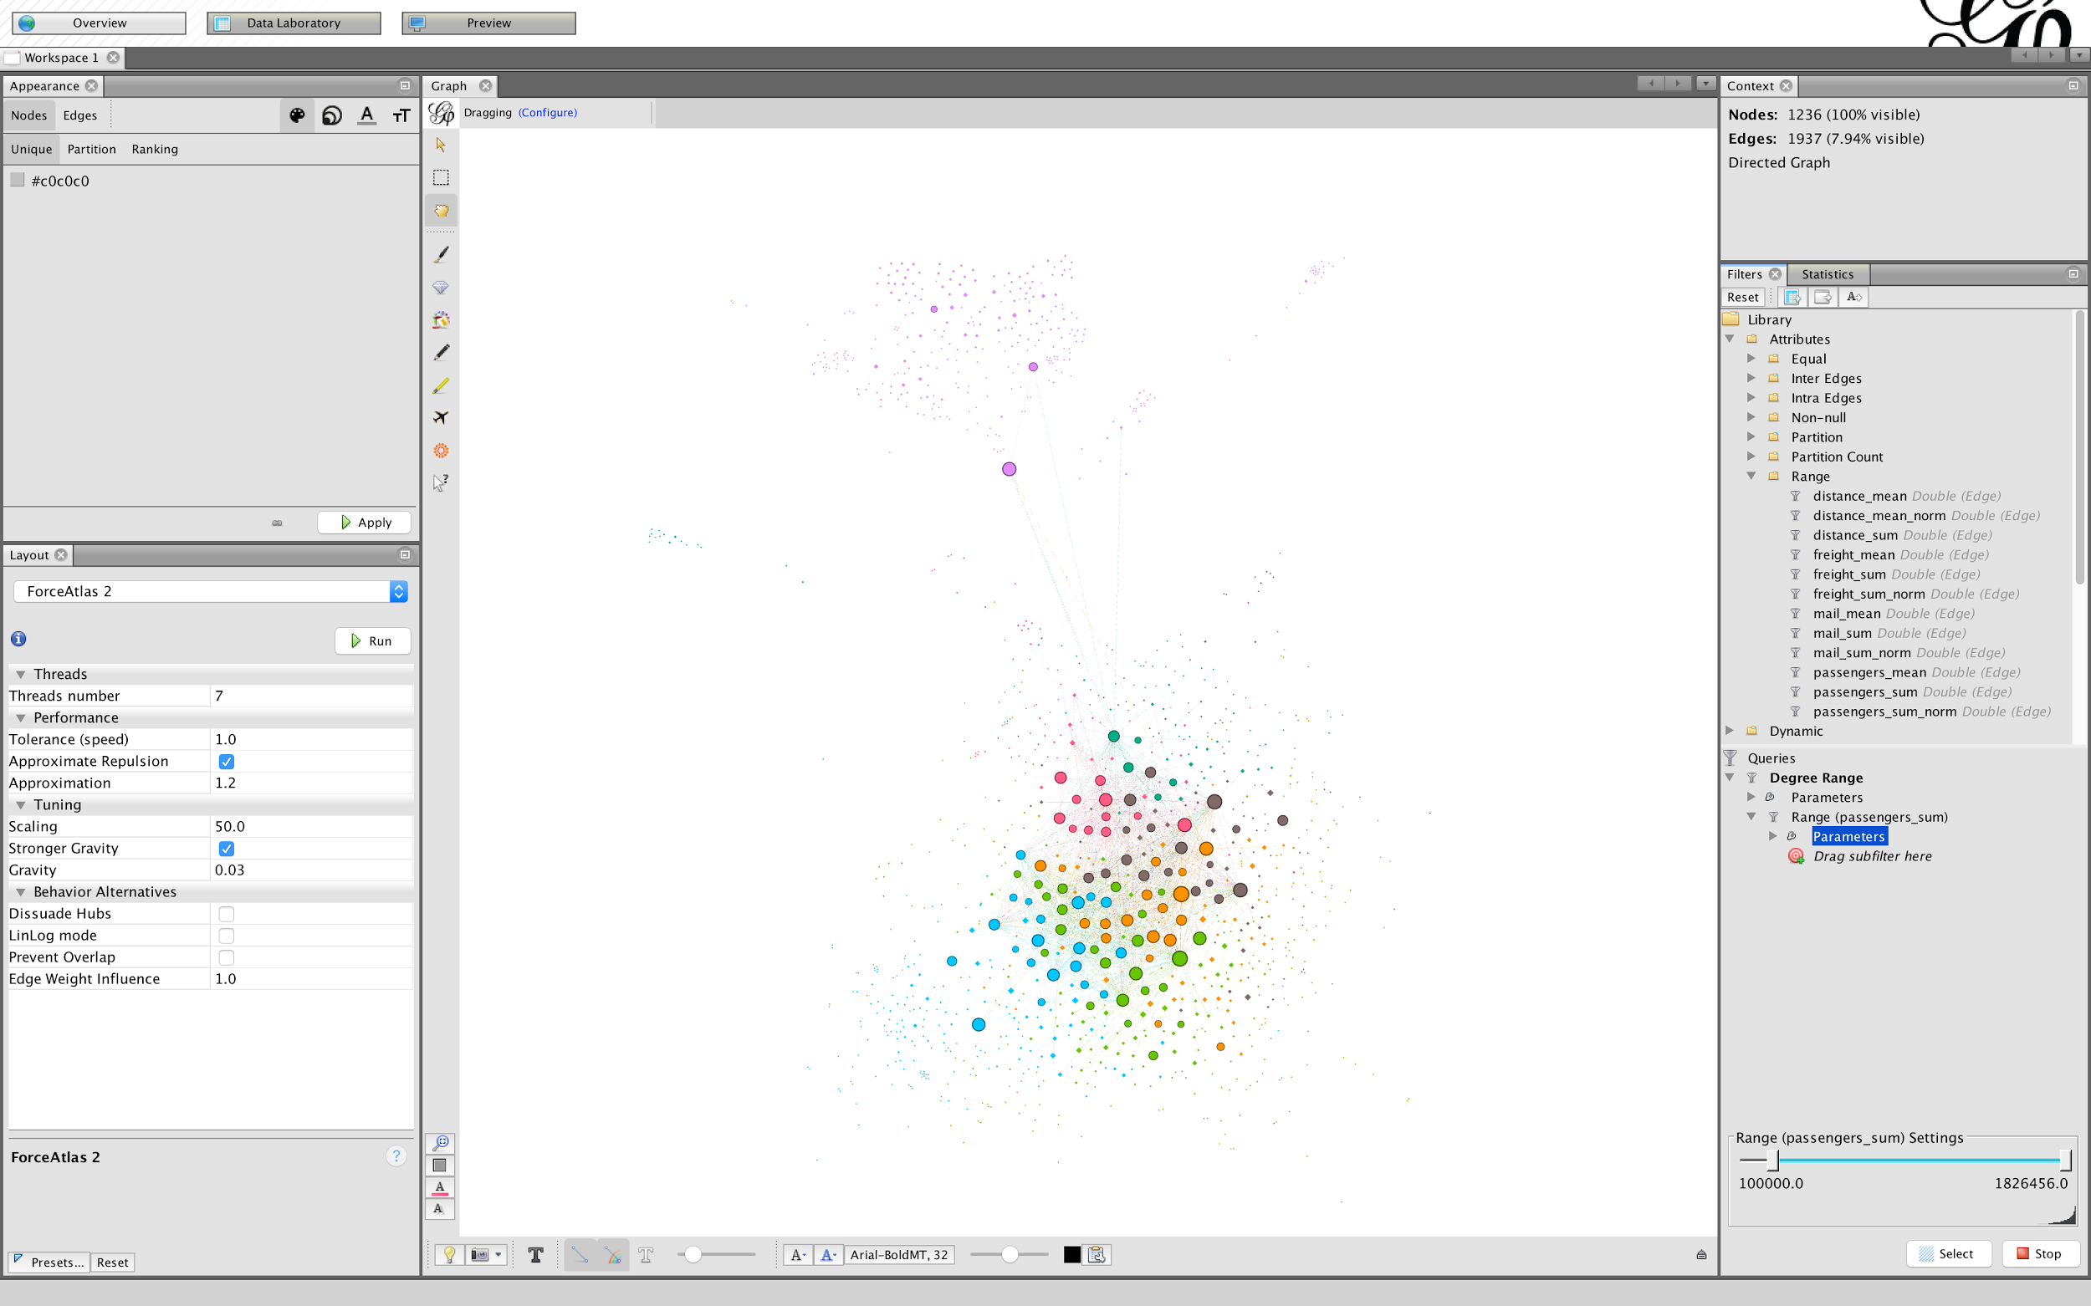
Notes:
… more than 100000. Click the "Filter" button to apply the filter. Note that the edges are gone, but the nodes remain. Our degree range filter hasn't been applied yet, and in fact won't be before we set our parameter range

Slide 36
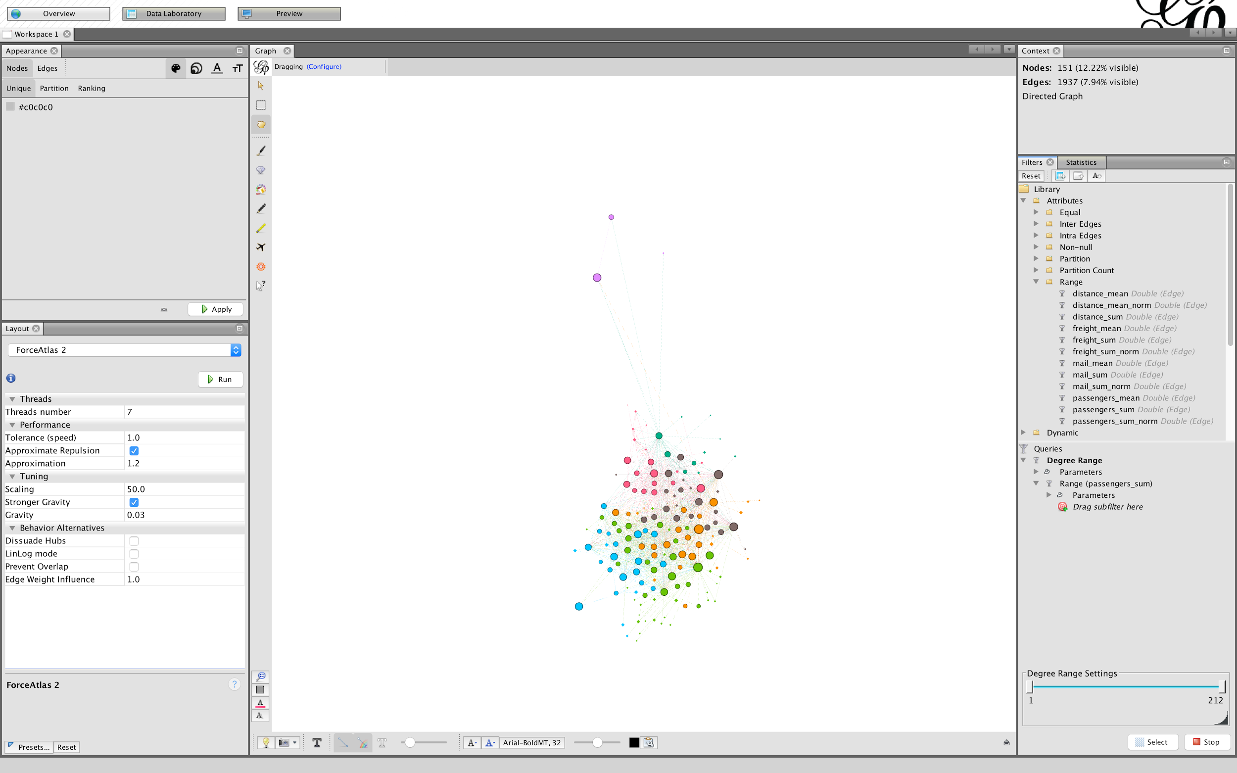
Notes:
But if we change the degree range filter to a minimum of one connection with the filter still running, we'll see those disconnected nodes disappear. You can keep the same layout if you want, but with the filter running, you're basically working with a new, more limited graph.

Slide 37
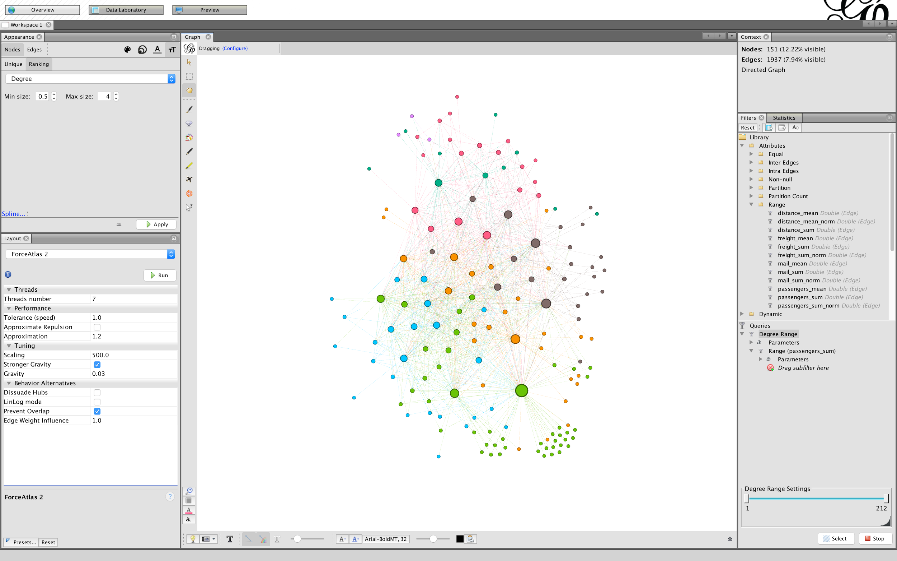
Notes:
Play with the scaling a bit, since this network is denser and smaller. I've set it to 500, and also turned off "approximate repulsion" and turned on "prevent overlap" to stabilize the model a bit (which i discovered through experimentation). You'll also want to update the degree -> size relationship, since there are different statistics for this filtered graph
With the power of filters, you can refine what you consider a relationship between nodes, or focus in on connections within a subset of your data, which is good for larger datasets like these.

Slide 38
Centrality
How important is a node in the network?

Slide 39
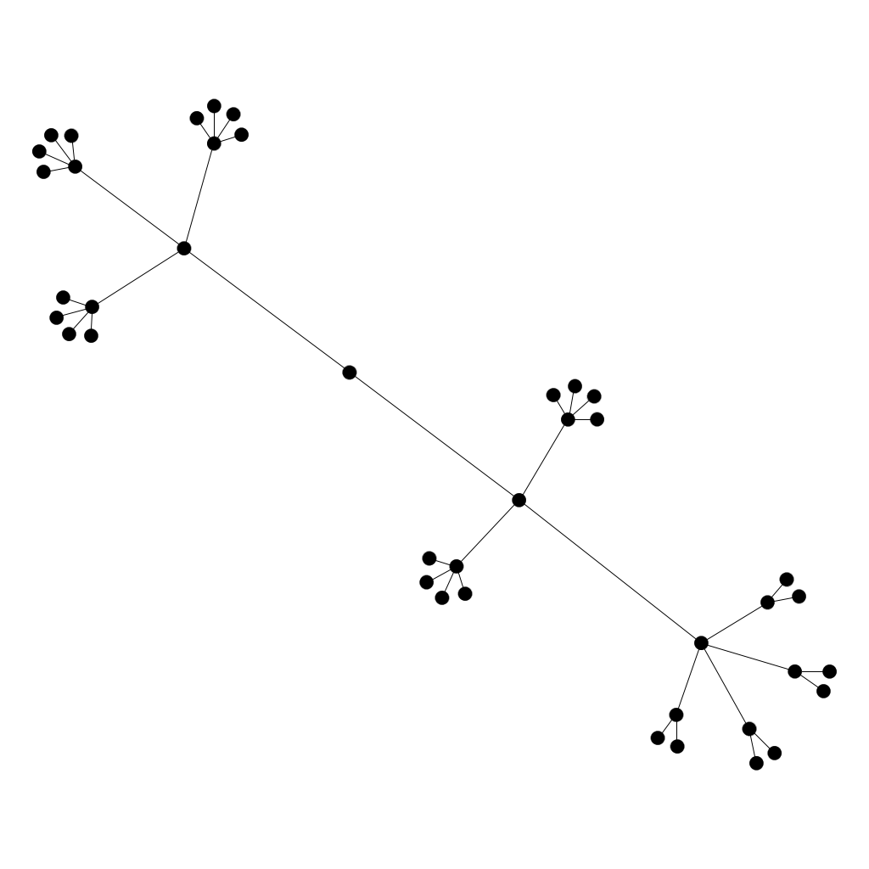
Sample Network
Notes:
We'll use this graph to highlight differences between centrality measures, currently unweighted, but force directed

Slide 40
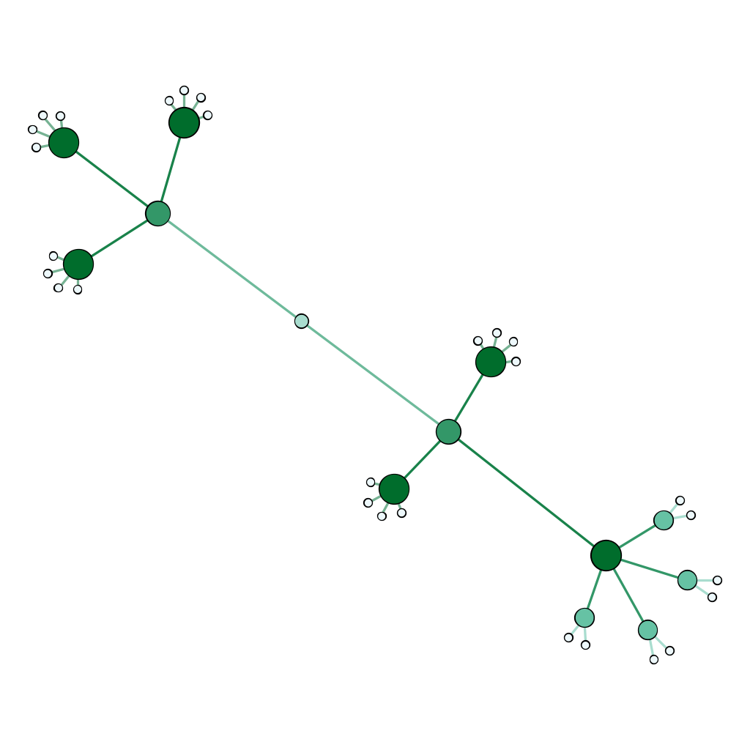
Degree
Notes:
Simple count of connections, this particular graph makes it look silly
Pros: cheap, built in, good in dense networks
Cons: not nuanced, doesn't actually tell you much about influence in the network

Slide 41
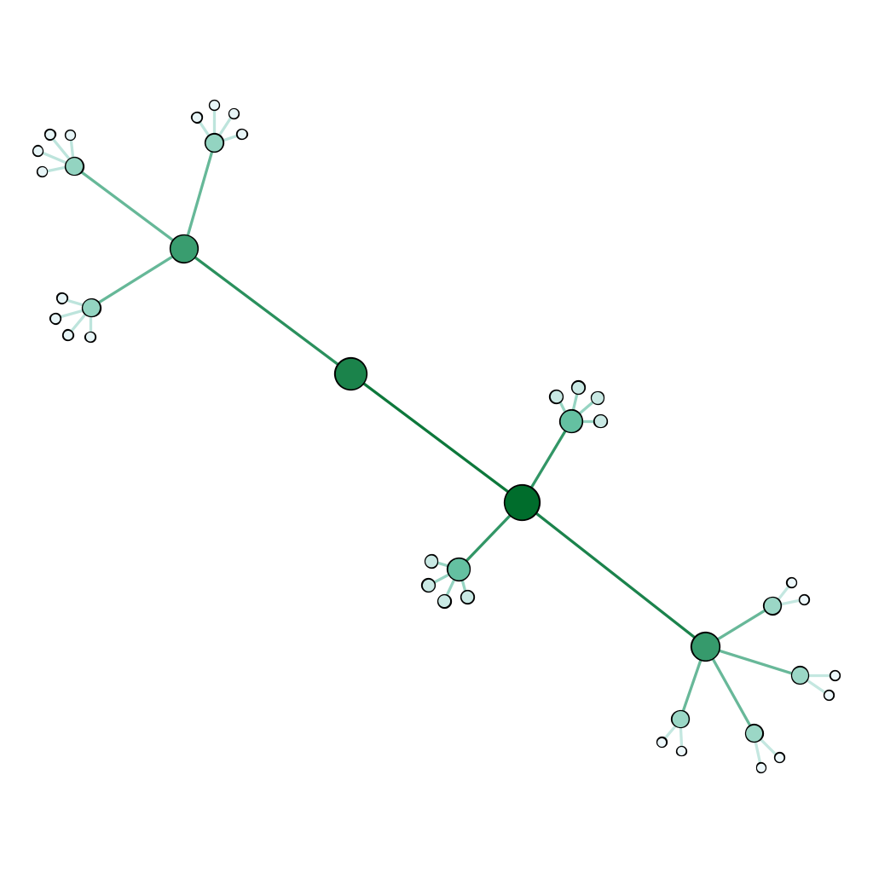
Closeness
Notes:
Closeness is how central a node is, how close to a "middle" it is. It's the inverse of the average distance between a node and every other node in the graph.

Slide 42
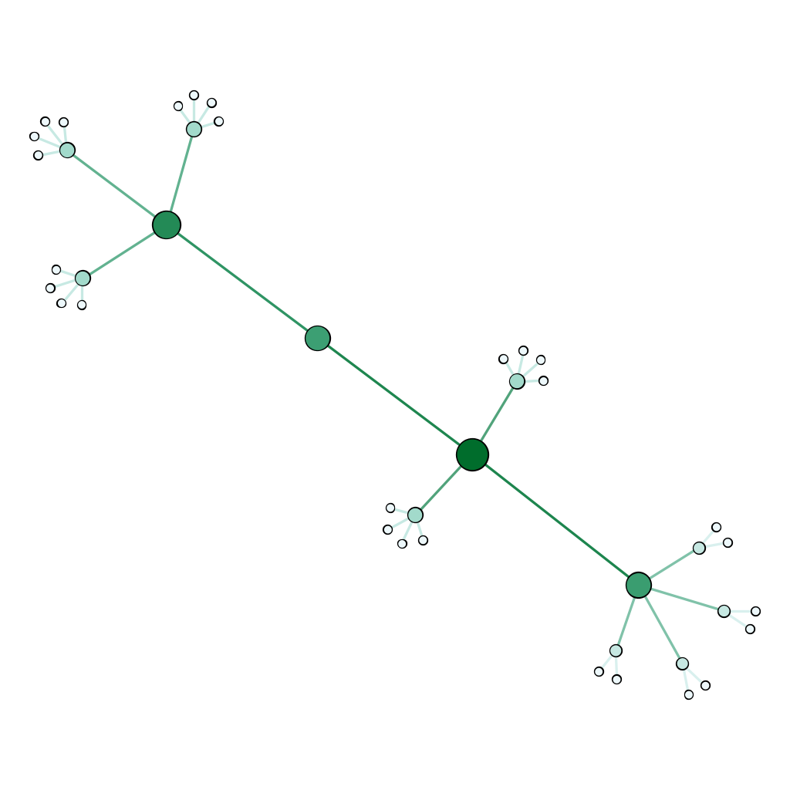
Betweenness
Notes:
Betweenness is a measure of how many connections between nodes run through a given node

Slide 43
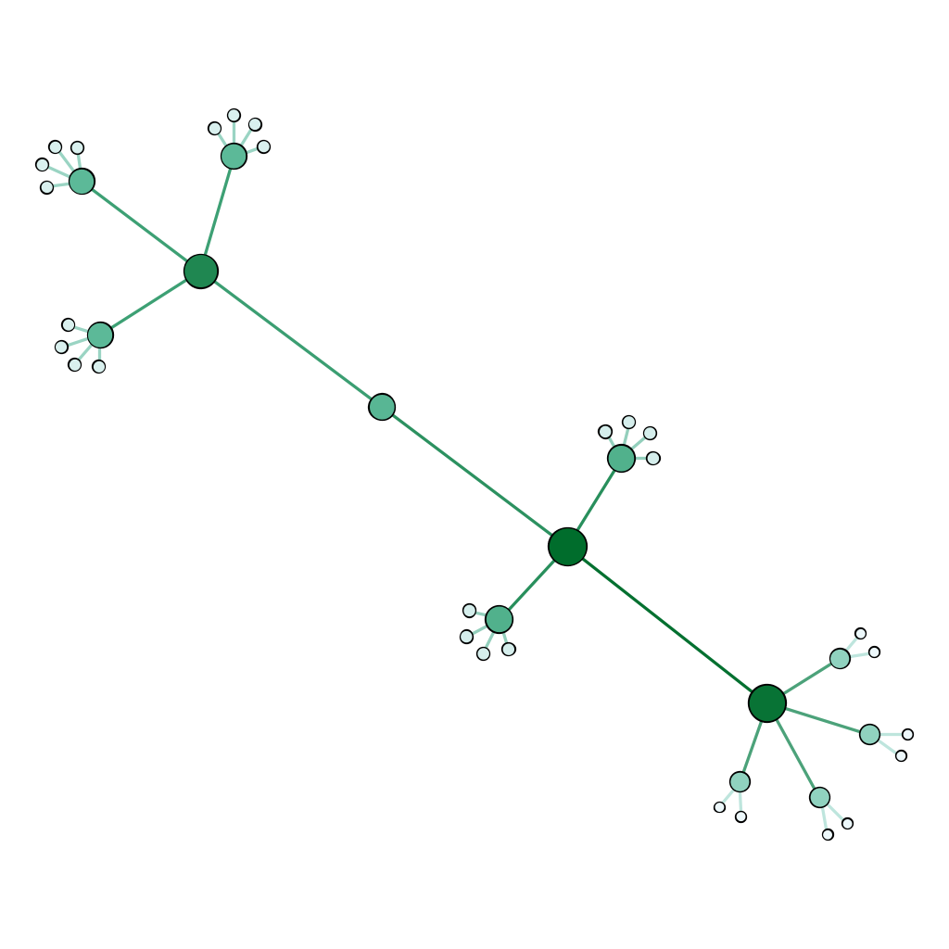
Eigenvector
Notes:
Eigenvector centrality is like a weighted degree centrality. It takes into account not only the number of connected nodes, but the connectedness of connected nodes, so some nodes count for more than others. The math is iterative and somewhat randomized, so your numbers should be mostly, but not exactly, the same running it multiple times on the same network

Slide 44
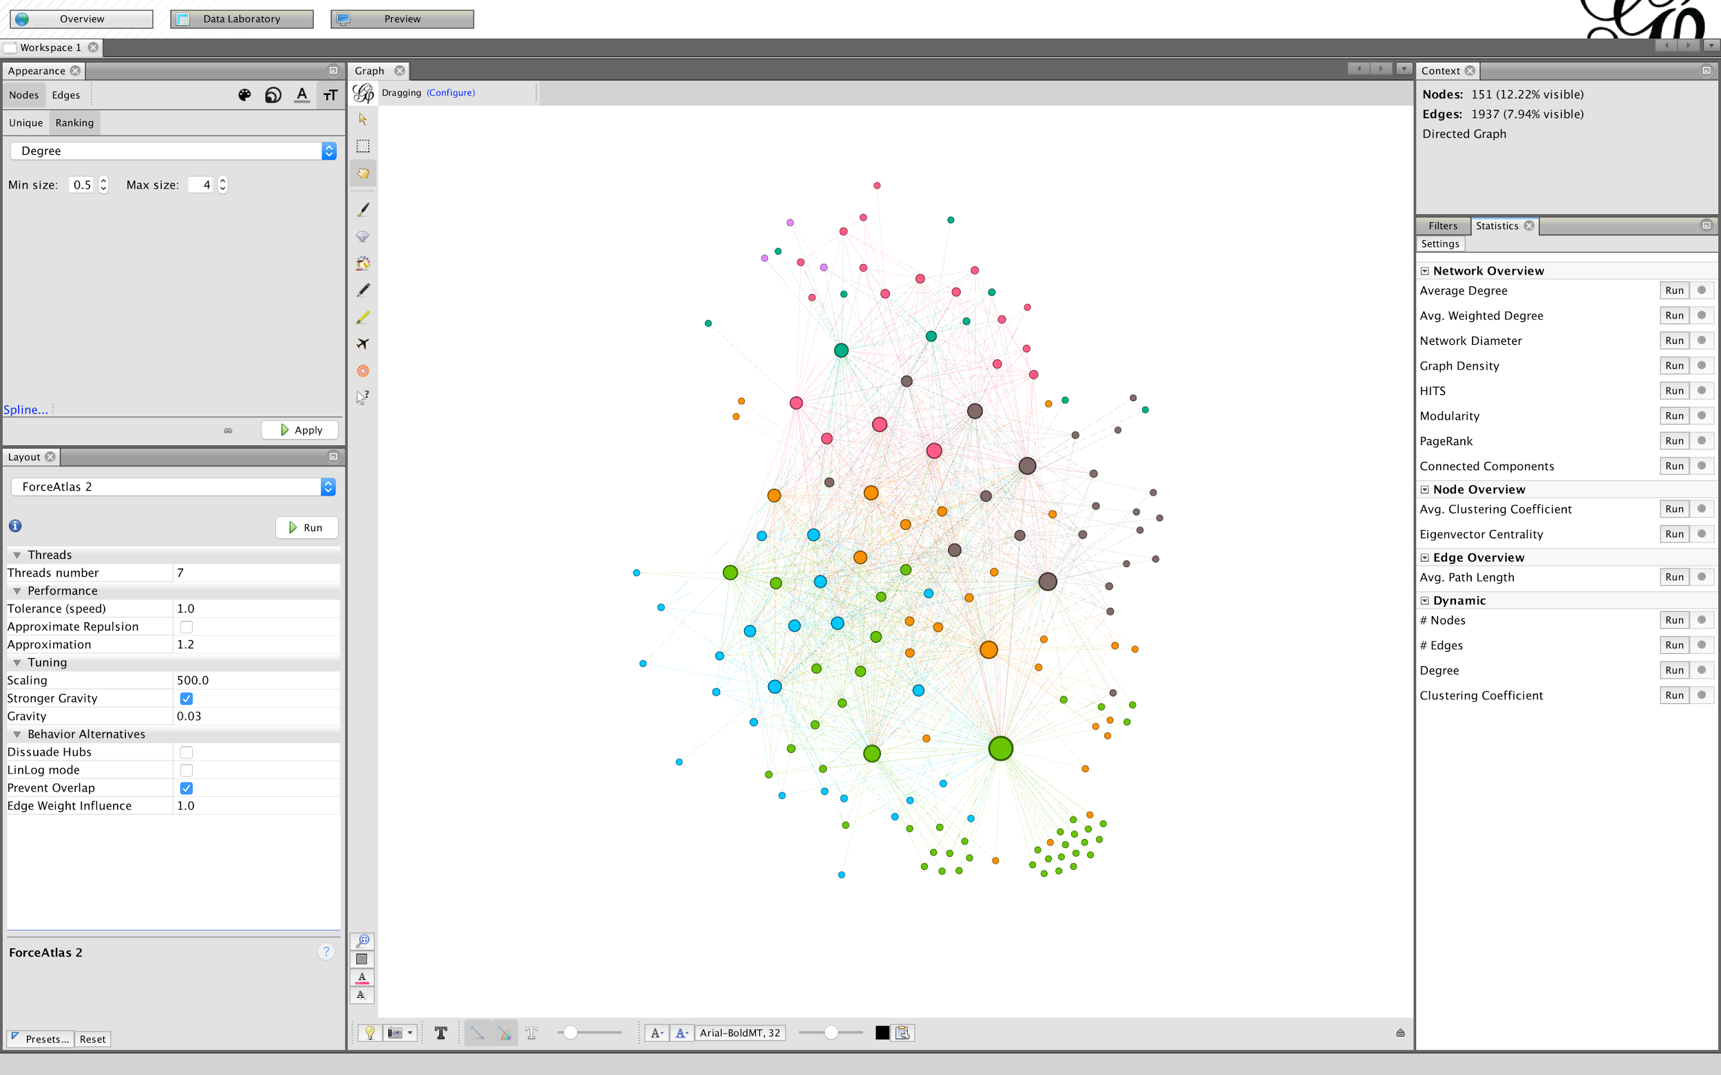

Slide 45
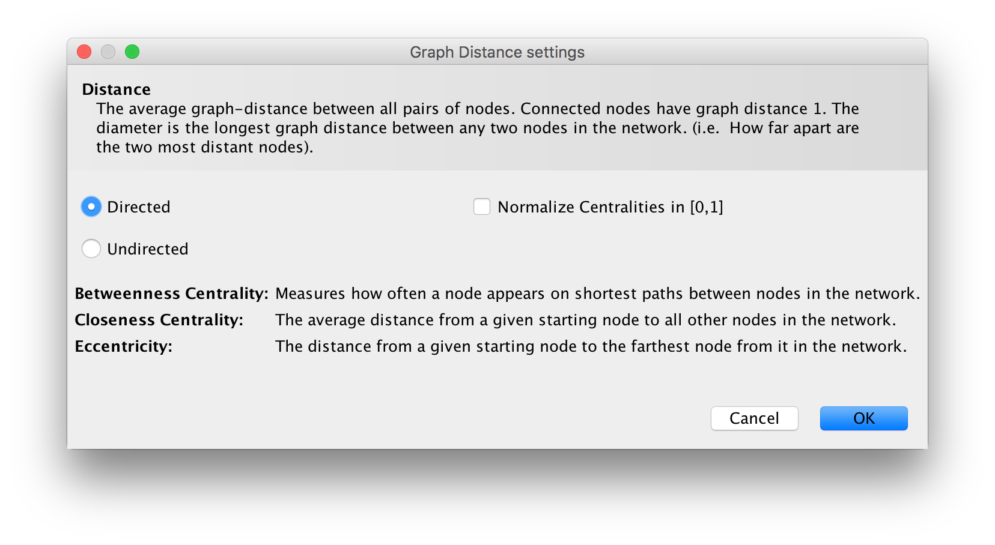

Slide 46
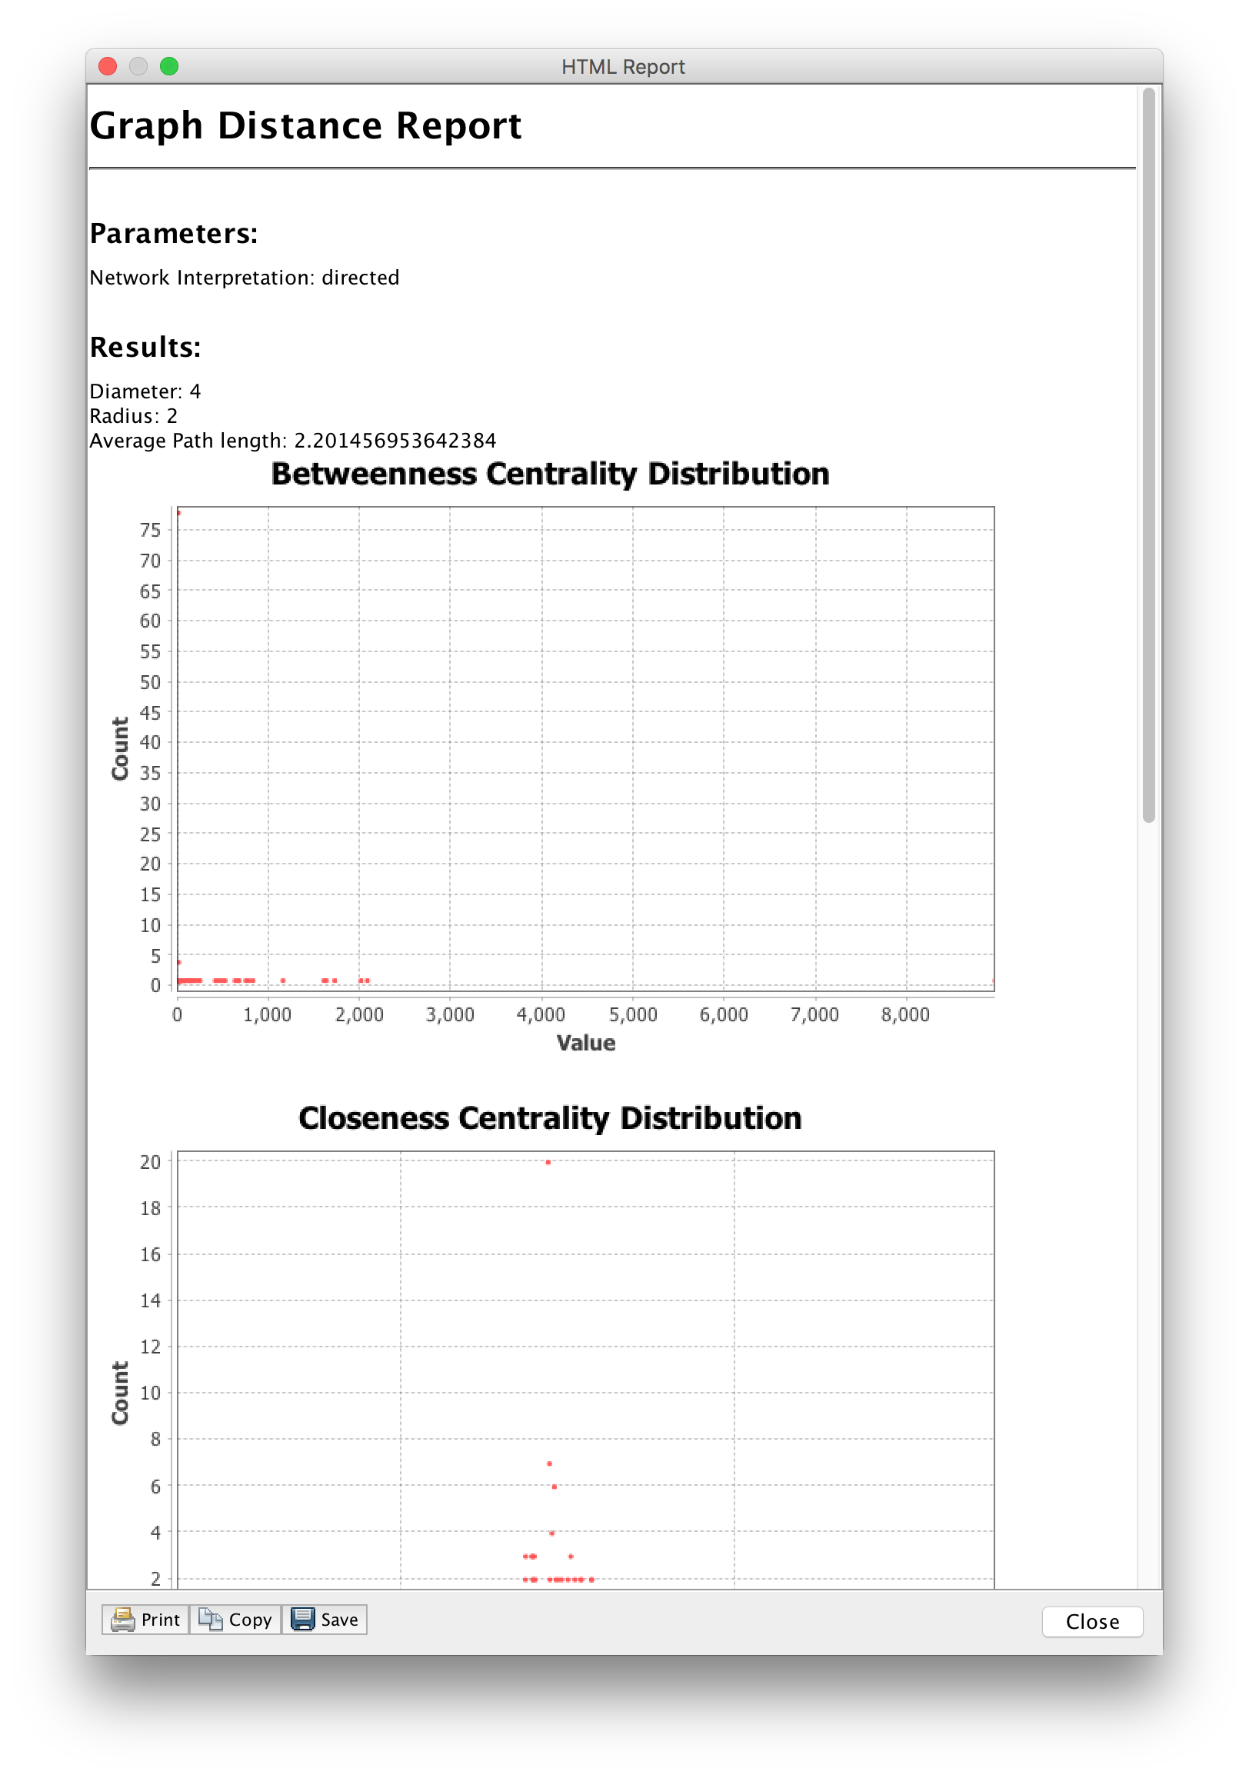

Slide 47
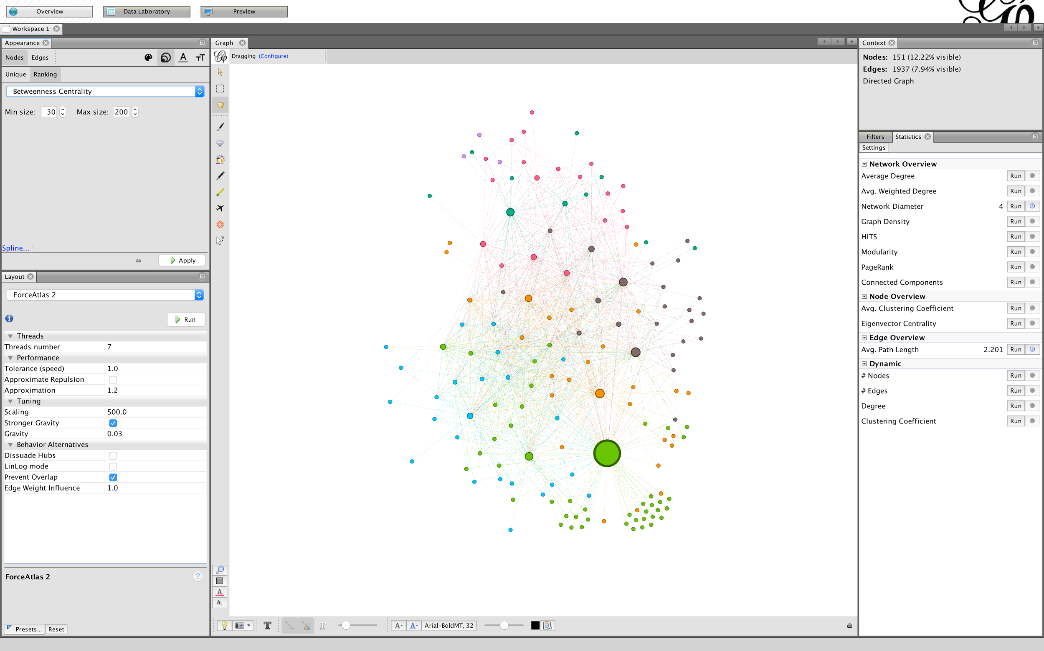

Slide 48
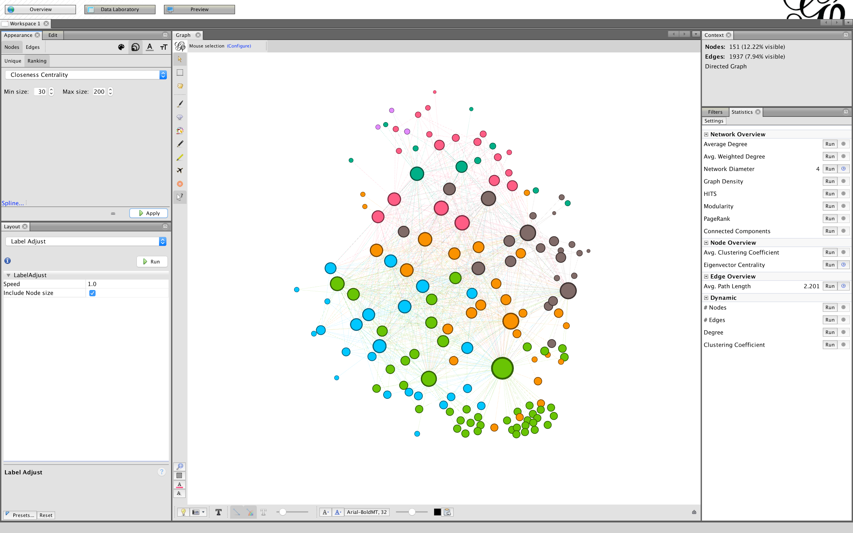

Slide 49
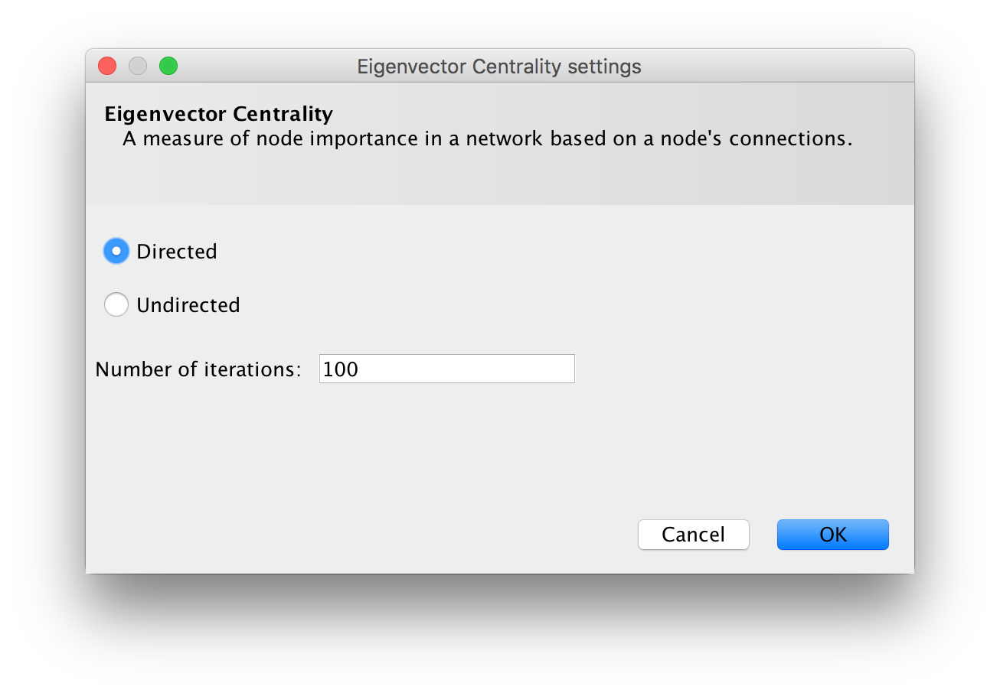

Slide 50
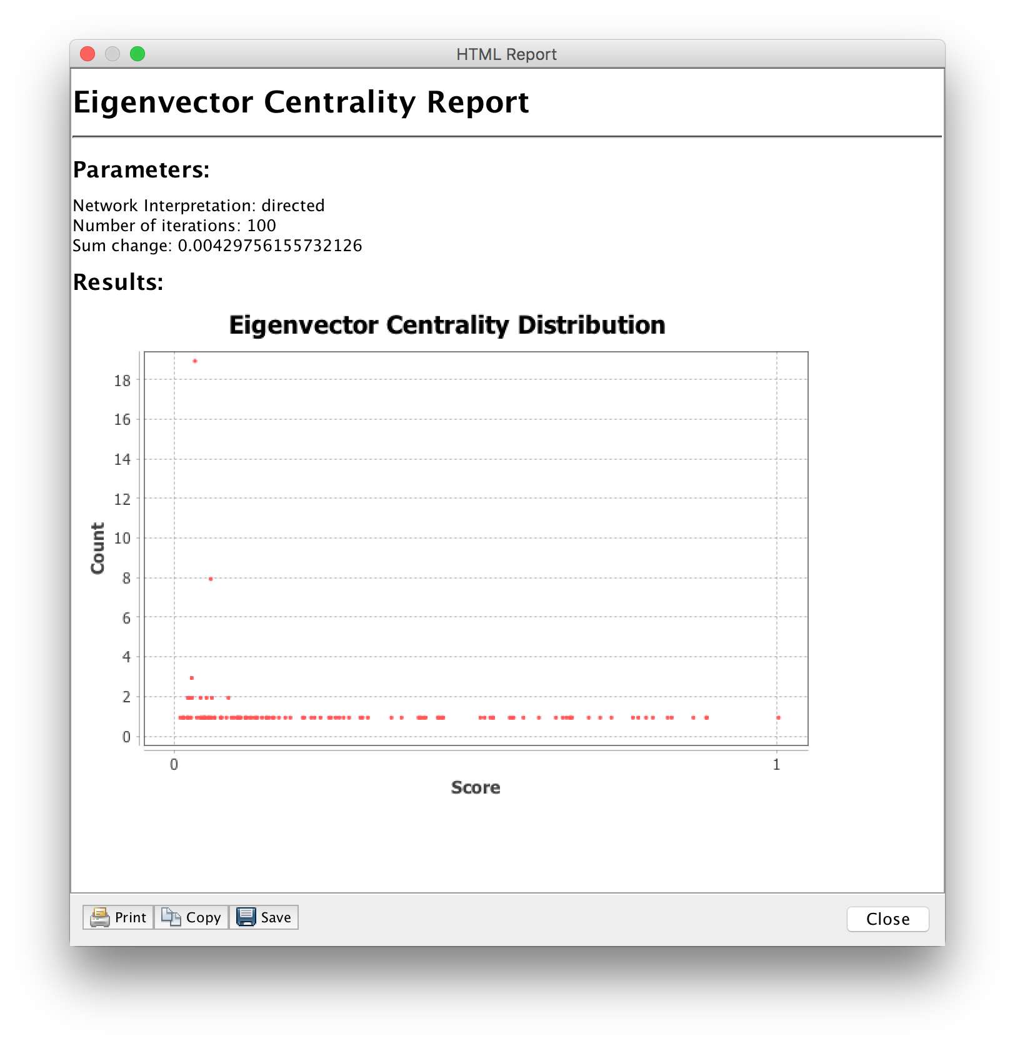

Slide 51
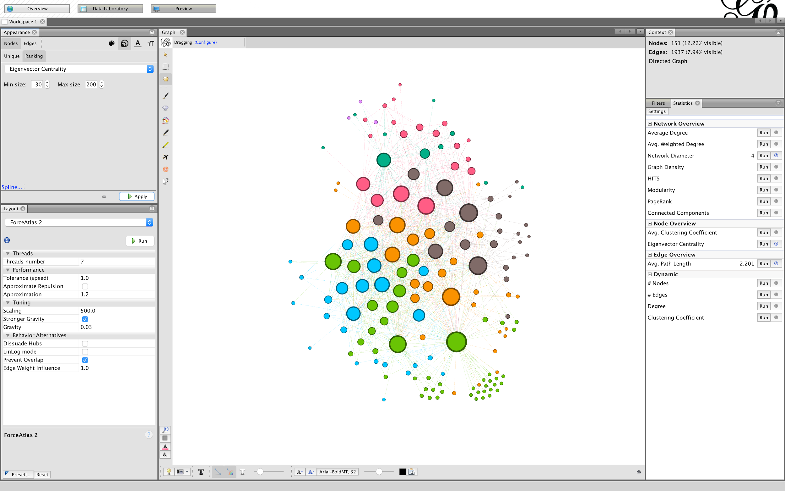

Slide 52
Sharing options
Export image (PNG, PDF, SVG)
Export graph file (.gexf, etc.)
Then use web renderers like gexf-js or Sigma js
Export node and edge tables (.csv, .tsv)

Slide 53


